Slide 1
Micro Business
By. Ahmed Mohamed Samir

Slide 2
MICRO, Core, Master

Slide 3
Micro, Master, Core Flow Steps
مسار عمل صغير : TypeCode == 1
Funding Request: طلب تمويل, LO, R111
Initial Review: مراجعة أولية, CO, CO1010
Field visit: زيارة ميدانية, CO, CO1311
Critical analysis: ,تحليل الائتمانيCO, CA1211
Uploading Documents: تحميل المستندات, BM, DU77
Central Review: المراجعة المركزية,Operator: Credit, LR55
إتمام توقيع
تم الصرف
مسار عمل كبير : TypeCode == 2
Funding Request: طلب تمويل, LO, R111
Initial Review: مراجعة أولية, CO, CO1010
Field visit: زيارة ميدانية, CO, CO1311
Critical analysis: ,تحليل الائتمانيCO, CA1211
Branch Manager Review: مراجعة مدير الفرع, BM, BMFR1
Central Committee: لجنة مركزية, BM, CMR
Uploading Documents: تحميل المستندات, BM, DU77
Central Review: المراجعة المركزية, Credit, LR55
إتمام توقيع
تم الصرف

Slide 4
Start Funding Request: R111

Slide 5
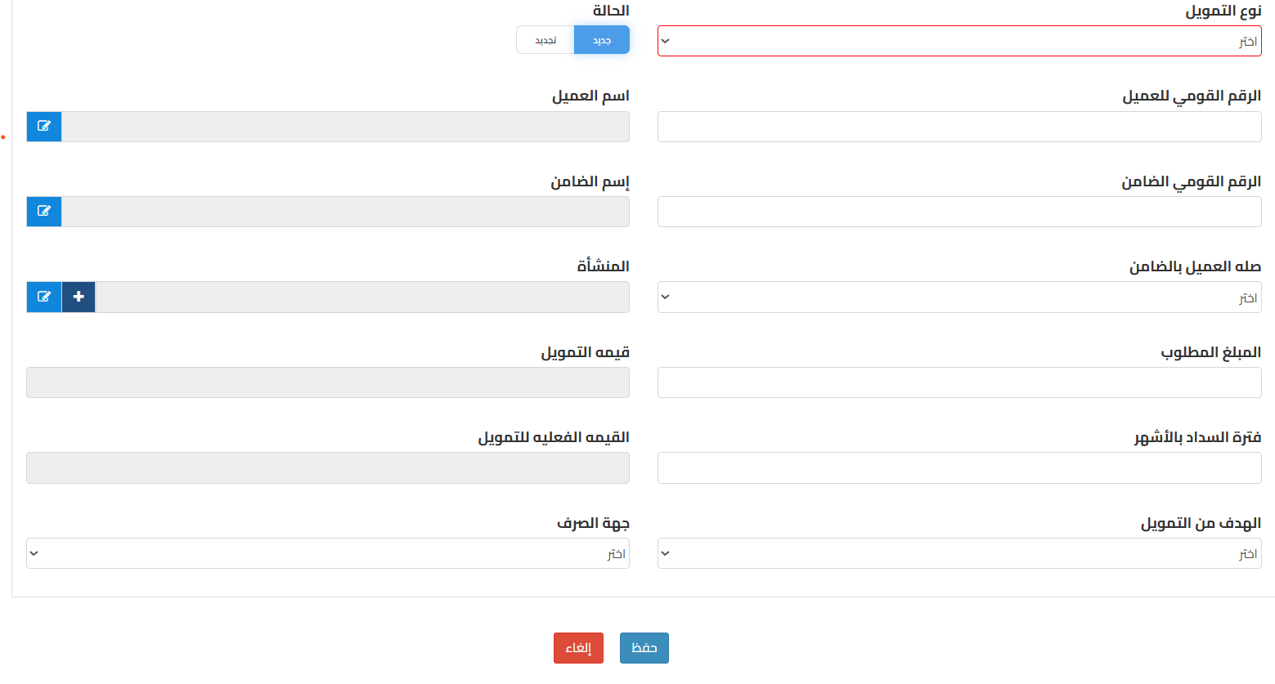
LO click on طلب جديد
علشان اجيب بعض البيانات الخاصة بتحميل شاشة طلب التمويل
Flow_Funding_requestController/GetAllFundingLoadList/{BranchId}/{UserId}
FundindPageLoadVM Flow_Funding_requestService GetAllFundingLoadList(branchId, userId)

Slide 6
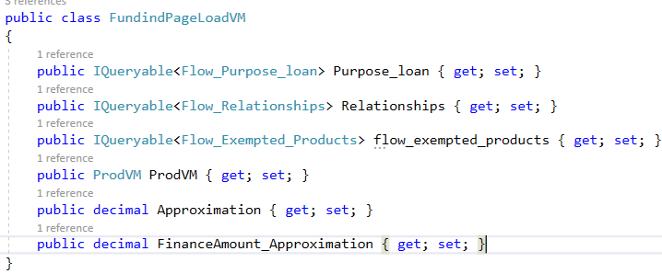
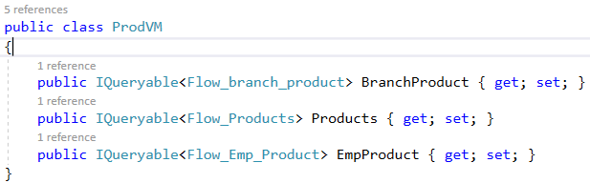
Request Loaded Data [البيانات الخاصة بطلب التمويل]
Load Purpose_loan [الغرض من التمويل] drop down
Load Relationships
Approximation: [1.00] from generalSetting
FinanceAmount_Approximation [1000.00] from General Setting
Load BranchProduct
Load AllProducts
.Where(s => s.Confirm_Score == 0);
Load EmpProduct
Load Exempted_products

Slide 7
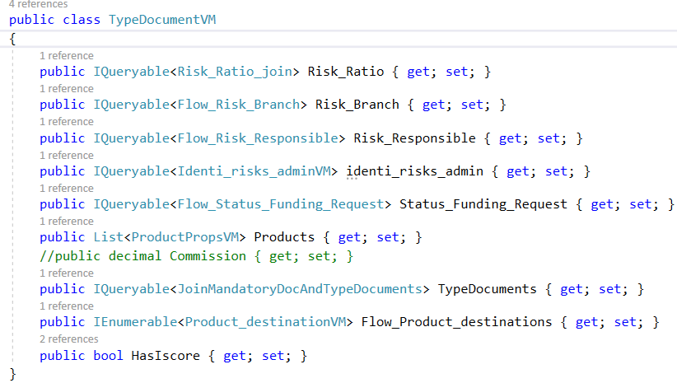
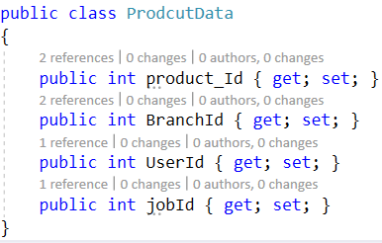
LO Select Funding Type [ نوع التمويل ]
بجيب كل البيانات الخاصة بالمنتج
Flow_Funding_requestController/GetAllTypeDocuments
TypeDocumentVM Flow_Funding_requestService.GetAllTypeDocuments ([FromBody] ProdcutData entity)

Slide 8
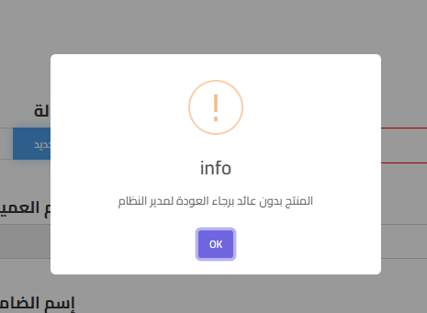
لو المنتج الذي تم اختياره بدون عائد
TWF.Flow_Product_Return
In case of Product.Flow_Product_Return.Where(x.product_Id == product_Id)

Slide 9
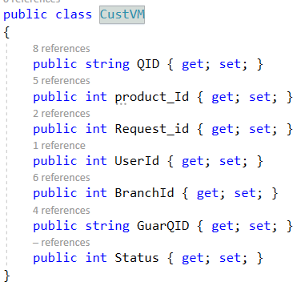
When click on اسم العميل After write customer Id
Flow_Funding_requestController/Flow_Funding_requestController/CustomerData // POST
CustomerData CustomerData(CustVM entity)
What CustomerData method do
Check if this Product Allow Or Not Allow To This Gender
The 13th digit from id if odd male else female
Check if Qid is for company employees of blacklist

Slide 10
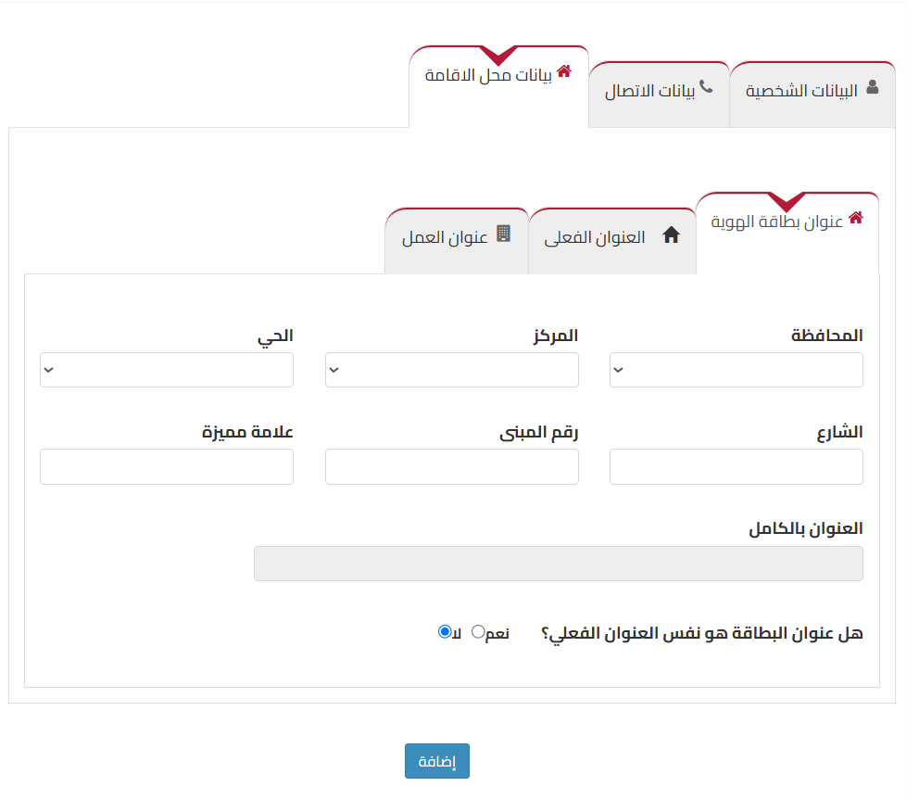

Slide 11
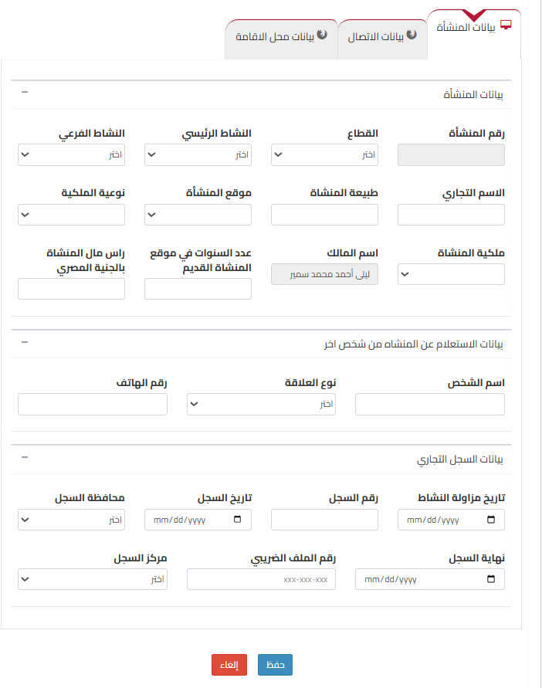

Slide 13
At customer, بيانات الاتصال
When user enter نوع الاتصال والرقم
Transactions/Flow_Contact_UsController/GetOne/{Mob_num}
Flow_Contact_Us GetOne (string Mob_num )

Slide 14
After user fill all customer data and add it
api/FlowChart/Transactions/Flow_CustomersController/Post
Post ( [FromBody] Flow_Customers entity)

Slide 15
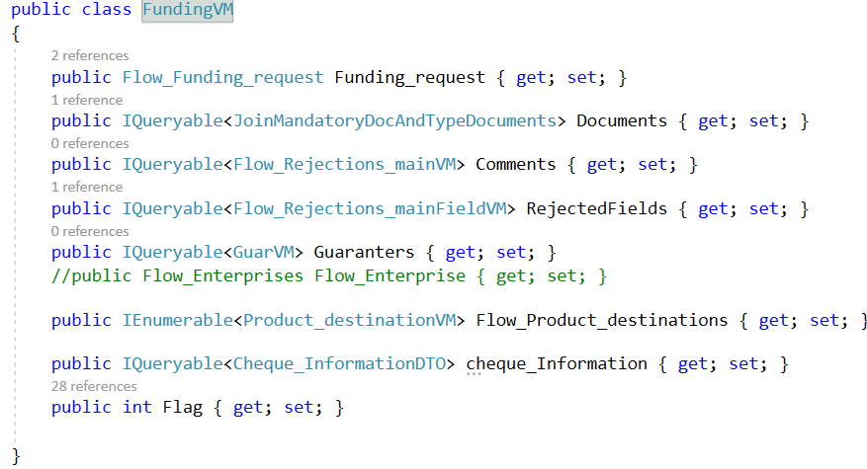
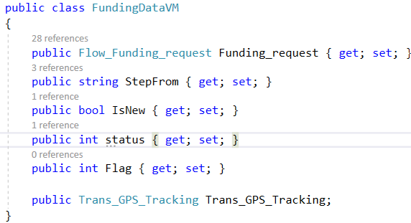
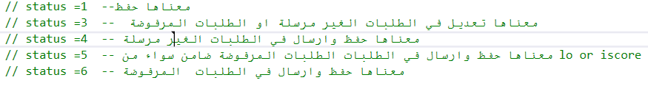
When Saving Request for the first time VIA LO
Transactions/Flow_Funding_requestController/InsertFunding
FundingVM Flow_Funding_requestService. InsertFunding( [FromBody] FundingDataVM entity )
FundingVM.Flag = 5 // لا يوجد مدير لهذا الفرع
IsNew : true
status : 1 == FixedStatus.Status_1_Is_Save
Flag : 0
Trans_GPS_Tracking = null

Slide 16
When Saving Request for the first time VIA LO [cont.1]
Flow_Funding_Request fields that will get a value
Open_date = _Trans_BusDate.Queryable().FirstOrDefault(ex => ex.BranchId == Funding_request.BranchId).BusDate;
FRC_Id = Product.FRC_ID;
APP_FEE = IsNew == true ? Product.Com_submit_new_app : Product.Com_submit_renew_app;
RATE = IsNew == true ? Product.Fixed_return_new:Product.Fixed_return_renew;
DEBTNO=Flow_Funding_request.where(c => c.Customer_ID == entity.Funding_request.Customer_ID).Count()+1
Where entity is FundingDataVM
RequestId: identity
UserId: Lo Id
BranchId: branch of LO
ComId: FK from Lookup.Company
ProductId: FK from Product
CustomerId: FK
EnterpriseId: FK

Slide 17
When Saving Request for the first time VIA LO [cont.2]
Flow_Funding_Request fields that will get a value
RequiredAmount
FinancingAmount
ActualFinancing
RepaymentPeriod
Request_Status,
StatusCode: 0 , FK from Flow_Status // request at LO
Layer_code [ from product ],
LoanCode[ from product],
Code_ED: FK from SWF.Flow_Exchange_Destinations [كود جهة الصرف],
Curr_code FK from [ Account.Acc_Currencie] , // 1 Egyptian Pound, 2 Dollar
purposeId,
CreationDate

Slide 18
When Saving Request for the first time VIA LO [cont.3]
Flag_History: bool, 1
PenaltyAmount: 0
Grant: bool, 0
Yield_periodicity: 0 // ?????
WriteOffFlag: 0
Securitization: 0
IsDisbursmented: 0
AccountCode: NULL
DEPT_VALUE: NULL
PRIMIUM_VALUE: NULL
F_PRIMIUM_DATE: NULL
L_PRIMIUM_DATE: NULL
BUSDATE: NULL // تاريخ الصرف
EXPDATE: NULL
Com_RATE: NULL // assigned at disbursement
Bank_code: NULL
VisitCount: NULL
GuarVisitCount: NULL
Approv_value: NULL
Approved_Amount: NULL
TOTAL_AMOUNT: NULL
NO_Months: NULL

Slide 19
When Saving Request for the first time VIA LO [cont.4]
Deportation Fields that will have a value
FRD_ID
Request_id
UserId_from = LO ID
UserId_TO = LO ID
UserId_BM = BranchManager.UserId
BranchId
JobId: 10: JobId of LO
Deportation.Name_step_from = CurrentActionStep;
Deportation.Name_step_to = CurrentActionStep;
CurrentActionsForAllType = base.Queryable().Where(x => x.Definition_number == Definition_number);
CurrentActionStep = CurrentActionsForAllType.FirstOrDefault(x => x.Type_code= Product.Type_code).Name_stepAR;
Deportation.Status_one = FixedStatus.Status_One_Inprocess // “inporoccess”
Deportation.Status_two = FixedStatus.Status_R111 // R111
Deportation.Type_code = FundingDataVM.status == 1 ? Product.Type_code : Deportation.Type_code;

Slide 20
When Saving Request for the first time VIA LO [cont.5]
Deportation Fields that will have a value
Date_creation_request
Customer_ID_C
Cust_QID
Cust_Full_name
Enterprise_ID
Product_id
Product_name
Code_action: null
Date_Assigned: null

Slide 21
When Saving Request for the first time VIA LO [cont.6]
Flow_Requests_Log
FRL_ID: PK
FRD_ID: FK from request_deportation
Date_Creation: date.now
Daily_date: date.now
Step_name: طلب التمويل
Definition_number: R111
ActionFlag: null;

Slide 22
When Saving Request for the first time VIA LO [cont.7]
At TWF.Flow_ISCORE_Data you will two records one for customer and one for guarantor
Cust_IDNO
Code_FID: PK
Inquiry_Date
Score
Open_Credits
Days_Due
No_Of_Inquiries
Request_id
Ref_NO
NotFound: 2
New_ISCORE: 1 [ always one ]
File Code: Mjk4MDkzMDE0MTI4NzQoMzQzMjBhOTItNzVmOC00N2M1LWI1ZDYtMjk1M2RjZWRkMGM2KS5wZGY=
Note: you will find FileCode here is equal to TWF.TWF_Download.Doc_id

Slide 23
When Saving Request for the first time VIA LO [cont.8]
TWF_Download: the table that represent the uploaded docs for request
You will have two records one for customer and one for guarantor these are docs related to iscore docs
Id_Down: PK, identity
Screen_name: C
Doc_id: string, Mjk4MDkzMDE0MTI4NzQoMzQzMjBhOTItNzVmOC00N2M1LWI1ZDYtMjk1M2RjZWRkMGM2KS5wZGY=
RequestId: 1693427
Bus_Date
Uploaded_Date
Field_ID: null

Slide 24
When Saving Request for the first time VIA LO [cont.9]
IQueryable<JoinMandatoryDocAndTypeDocuments> Flow_DownloadService.GetAllDocumentsLo( product_Id, jobId, Request_id)
It returns the uploaded docs + required docs

Slide 25
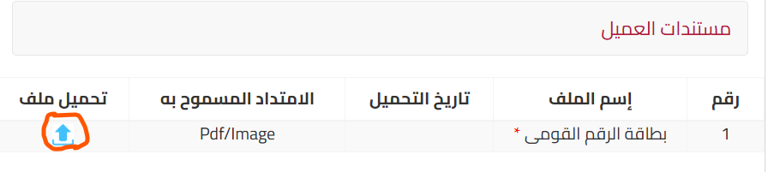
When Saving Request for the first time VIA LO [cont.10]
Documents tab [ المستندات ]
After click on تحميل ملف
https://coretest-uploadfile.tamweely.local:4154//api/UploadFile/UploadDocument
The response {
"success": true,
"FileID": [ "TmF0aW9uYWxfSWQxKGZkMWQzYTg4LThmMWQtNGMwNi1iMTMzLWRmZmMzMzA5YTcwNCkuanBn" ]
}

Slide 26
When Saving Request for the first time VIA LO [cont.10]
AT Documents tab [ المستندات ]
After click on تعديل
Flow_Funding_requestService.InsertDocument (List<documentsFiles> filesupload, decimal id, List<Flow_Download> OldDocs)
The uploaded docs will be saved on TWF.TWF_Download table
Screen_name
DG444 : مستندات الضامن // Scr_DefCode from flow_tabs
DG333 : مستندات العميل // Scr_DefCode from flow_tabs
Field_ID
1000 : بطاقة الرقم القومي-ضامن // docId From types_documents
1 : بطاقة الرقم القومى // docId from types_documents

Slide 27
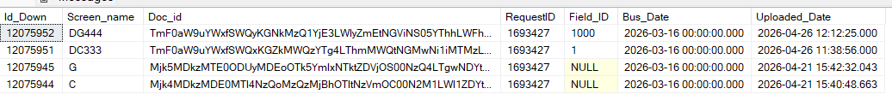
The uploaded files in this stage

Slide 28
When Saving Request for the first time VIA LO [cont.9]
TWF.Flow_Customers
Csutomer fields are filled

Slide 29
When Saving Request for the first time VIA LO [cont.9]
TWF.Flow_Funding_Guaranter
requestId : from request
guarantorId : from Flow_Customer

Slide 30
After LO حفظ وإرسال
The Funding_request
Status_code: from 0 [at LO] to 56 // deported to CO
Request_Deportation
UserId_to = 5642 // from LO UserId to CO UserId
Name_step_to: from طلب تمويل TO مراجعة أولية
Code_action (from: Flow_Actions): from null to 1
Status_one: from Inprocess to Approved --- means the Name_step_from : طلب تمويل is approved
Status_two: from R111 to CO1010 (مراجعة اولية) -- المرحلة الحالية
Date_Assigned: from NULL to current datetime
Requests_Log
Action_Flag : at first row from NULL to 5 [ حفظ وإرسال ]
Another record is added with UserId of CO

Slide 31
End Funding Request (R111)

Slide 32
Start Initial Review مراجعة أولية (CO1010)

Slide 33
When CO Opens Funding Request
Flow_Funding_dataController/GetOne
Flow_Funding_dataService. GetOne

Slide 34
When CO click on tab مراجعة المسئول الأول
Flow_Funding_dataController/PageLoad/{Request_id}/{Scr_DefCode}
PageLoadVM Flow_Funding_dataService.PageLoad(reqID, Scr_DefCode);
Scr_DefCode = CO1010
PageLoadVM.Tabs
GetOnlyThisTabs = { "R111", "C333", "G444", "E555", "D222", "DC333", "DG444", "DE555" };
PreviousStepsForThisRequest = from _RequestLog get distict Definition_number of the request and add then into GetOnlyThisTabs
When you select from select input اختر الشاشة
Flow_Link_Screen_componentsController/GetFields/{tabs_code}
IQueryable<Flow_Screen_components> Flow_Link_Screen_componentsService.GetFields()

Slide 35
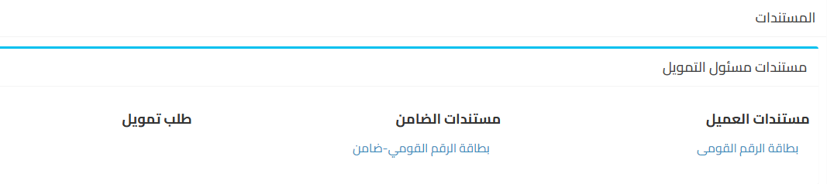

When CO click on tab المستندات
Flow_DownloadController/GetAllDownloadDocumentsFunding/{Request_id}
Flow_DownloadService. GetAllDownloadDocumentsFunding( Request_id )

Slide 36
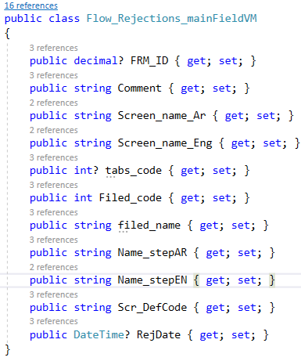
When CO click on أسباب الرفض
Flow_Rejections_mainController/GetAllReasonsRejectionByRequest_id/{Request_id}
IQueryable<Flow_Rejections_mainFieldVM> Flow_Rejections_mainService.GetAllReasonsRejectionByRequest_id ( Request_id )

Slide 37
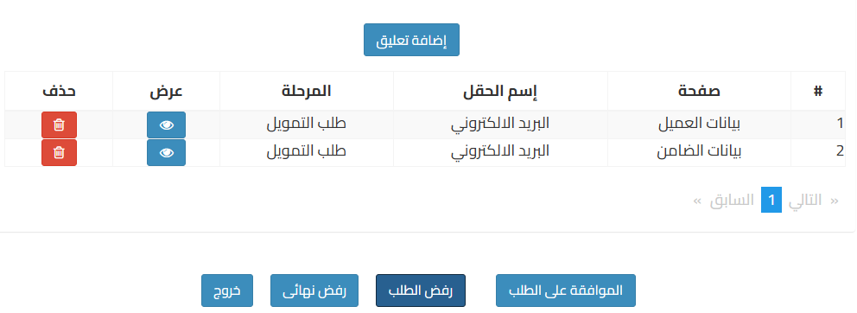
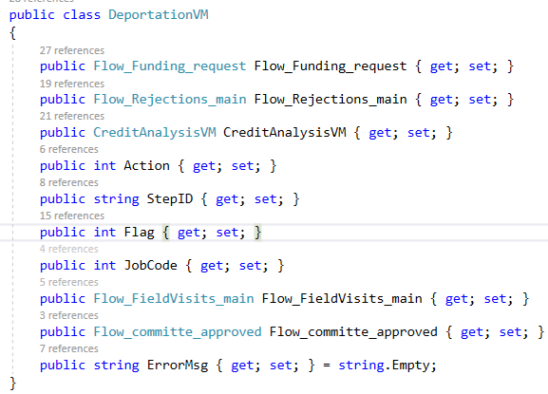
When CO at tab مراجعة المسئول الأول
When click on رفض الطلب
Flow_Funding_requestController/ExecuteFieldsRejected
DeportationVM ExecuteFieldsRejected ( DeportationVM entity )

Slide 38

When CO at tab مراجعة المسئول الأول [ cont.]
After request is rejected via CO رفض
TDWF.Flow_Rejections_main
UserId: the CO id who reject the request
Reject_by_phase: CO1010 // The stage at which the request was rejected
RequestId: the request
Remarks: تم الرفض من مرحلة المراجعة الأولية
InsertDate: date
Rejection_flag: 2
TDWF.Flow_Rejections_SubOne
FRSO_ID [PK]
tabs_code [FK] from Flow_Tabs
Field_name
Field_code
UserId: LO User who will receive the rejection
Phase_back_to: string
Comment: string
FRM_ID [FK] from Flow_Rejection_Main
Rejection_Flag
1 | رفض نهائي
2 | رفض حقول من مراجعة أولية أو من مراجعة مركزية
3 | رفض عادي كتابة سبب فقط

Slide 39

When CO at tab مراجعة المسئول الأول [ cont.2]
After request is rejected via CO رفض
Flow_Request
Status_code: 56 why it means it still deported at CO but it
Flow_Request_Deportation
Code_action: 2 -- from flow_action, type code is 1
Name_step_from: مراجعة أولية
Name_step_to: طلب تمويل
UserIdTO: LO
Status_one: reject
Status_two: R111
TDWF.Flow_Requests_Log
Last record
Action_Flag from NULL to 0 [ رفض ]
New Record
UserId: LO id
Action_Flag: NULL

Slide 40
The Rejected requests at LO
When LO open a request from rejected requests
Flow_Funding_requestController/GetAllFundingLoadList/{BranchId}/{UserId}
Flow_Funding_requestController/GetOneFundingRequest/{Request_id}
When LO click on tab اسباب الرفض
Flow_Rejections_mainController/GetAllReasonsRejectionByRequest_id/{Request_id}
When LO click on tab التعليقات
Flow_Rejections_mainController/GetAllRejectionCommentsByRequest_id/{Request_id}

Slide 41
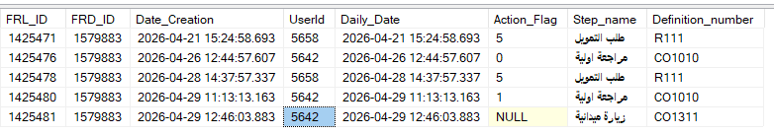
After CO Accept the request
Flow_Request
NO change
Flow_Request_Deportation
Code_action: 2 -- from flow_action, type code is 1
Name_step_from: مراجعة أولية
Name_step_to: زيارة ميدانية
UserId_TO: CO
Status_two: CO1311
TDWF.Flow_Requests_Log
Last record
Action_Flag from NULL to 1 [قبول ]
New Record
UserId: CO
Action_Flag: NULL

Slide 42
End Initial Review مراجعة أولية (CO1010)

Slide 43
Start Field visit: زيارة ميدانية, CO1311, CO

Slide 44
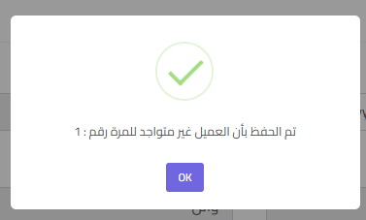

الزيارة الميدانية للعميل
When CO click on لم يستدل عليه
Flow_Funding_requestController/CalculateVisitCount/{RequestID}
Flow_Funding_requestService. GetOneRowOfFlowFundingRequest
Funding_Request
VisitCount from Null to 1
If VisitCount reached to 3 the request will be رفض نهائي

Slide 45
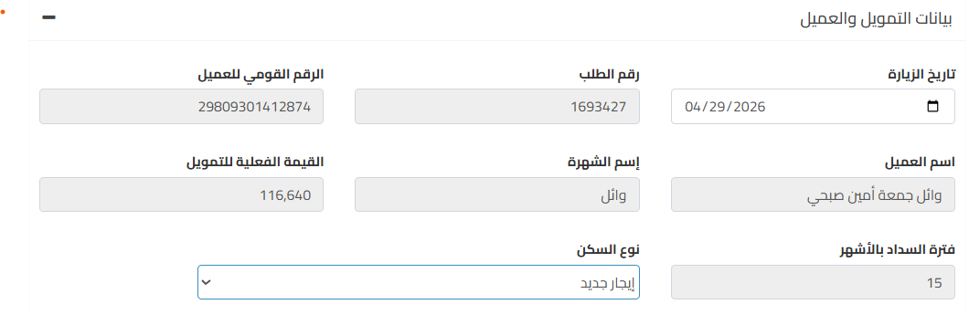
الزيارة الميدانية للعميل
بيانات التمويل والعميل
When CO click on لم يستدل عليه
بيانات التمويل والعميل

Slide 46

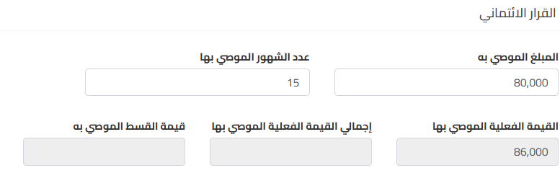
الزيارة الميدانية للعميل
القرار الائتماني
After fill المبلغ الموصي به و عدد الشهور
Flow_repayment_cycleController/GetOne/{FRC_Id}
IFlow_repayment_cycleService. GetOne(FRC_Id)

Slide 47
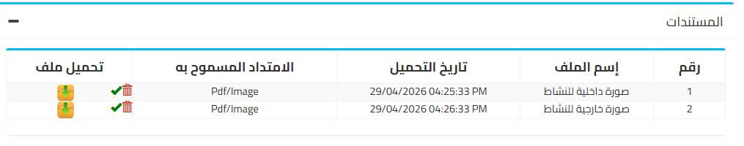
الزيارة الميدانية للعميل
المستندات

Slide 48
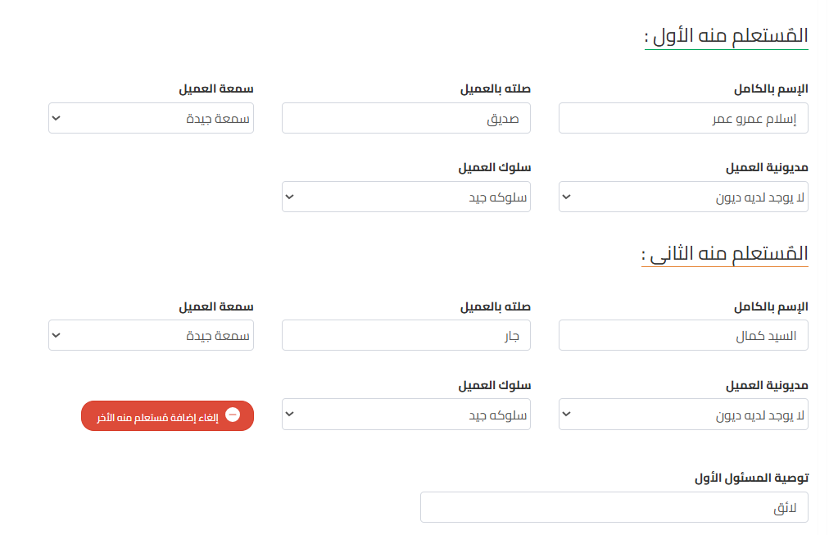
الزيارة الميدانية للعميل
الإستعلام الميدانى للعميل

Slide 49
حفظ جميع بيانات الزيارة الميدانية للعميل
Flow_FieldVisits_mainController/InsertOrUpdateFlow_FieldVisits_ClientsWithDocuments
TWF.TWF_Download
These two records Due to : الصورة الداخلية والخارجية للمنشأة
715: صورة خارجية للنشاط FK from Flow_Types_documents
716: صورة داخلية للنشاط

Slide 50
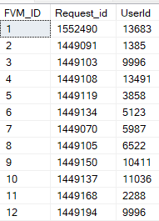
TDWF.Flow_FieldVisits_main
Once CO make any changes for the first time row is added into this table
FVM_ID: int , identity
Request_id : decimal? [FK, Flow_Funding_request]
UserId: int? [FK, from User] // the CO
ICollection<Flow_FieldVisits_Client> Flow_FieldVisits_Client
ICollection<Flow_FieldVisits_Guarantor> Flow_FieldVisits_Guarantor
ICollection<Flow_FieldVisits_Organization> Flow_FieldVisits_Organization
ICollection<Flow_FieldVisits_StatisticsData> Flow_FieldVisits_StatisticsData
ICollection<Flow_FieldVisits_FinancialAnalysis> Flow_FieldVisits_FinancialAnalysis
ICollection<Flow_FieldVisits_FieldInquiry> Flow_FieldVisits_FieldInquiry

Slide 51
TDWF.Flow_FieldVisits_Client
int FVC_ID [ PK]
DateTime? visit_date
string Residence_Type: نوع السكن
إيجار جديد, إيجار قديم, تمليك
decimal RecommendedAmount
decimal recommend_num_months
decimal recommended_funding [calculated]
decimal recommend_total_funding [calculated]
decimal premium_amount [calculated]
string CO_Recommendation
decimal? FVM _ID [ FK, Flow_FieldVisits_main ]
القرار الإتماني
RecommendedAmount
Recommend_num_months
Recommended_funding
premium_amount
recommended_funding
recommended_total_funding
بيانات التمويل والعميل
تاريخ الزيارة [ FieldVisit ]
نوع التمليك [ Residence_Type ]
الاستعلام الميداني للعميل
توصية المسئول الاولCO_Recommendation

Slide 52
TDWF.Flow_FieldVisits_FieldInquiry
This table represent الاستعلام الميداني للعميل والضامن
int FVFI_ID
string InquiriedPerson_Name // اسم الشخص المستعلم منه
string Relation // صلته بالعميل او الضامن
string Reputation // او الضامن سمعة العميل
string indebtedness //مديونية العميل او الضامن
string Attitude //سلوك العميل او الضامن
int InquiriedPerson_Number //(رقم المستعلم منه( الأول او الثانى
string InquiriedPerson_About //( المستعلم منه عن ( العميل /الضامن
decimal? FVM_ID //FK_Of_FlowField_VisitsMain_TBL

Slide 53
الزيارة الميدانية للضامن
When CO click on لم يستدل عليه
Flow_Funding_requestController/CalculateVisitCount/{RequestID}
Flow_Funding_requestService. GetOneRowOfFlowFundingRequest
Funding_Request
GuarVisitCount from Null to 1

Slide 54
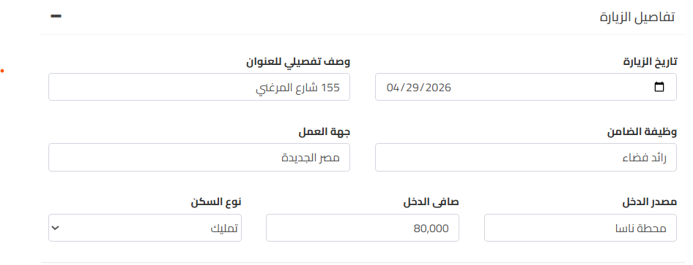
الزيارة الميدانية للضامن

Slide 55
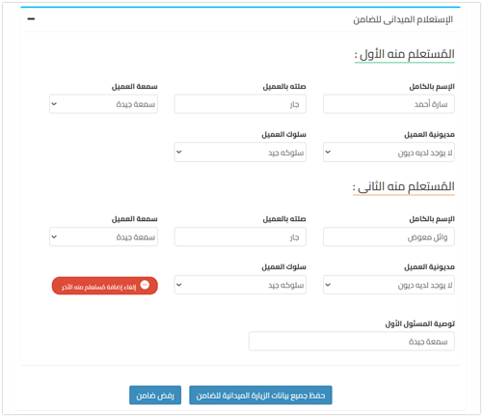
الزيارة الميدانية للضامن
الإستعلام الميدانى للضامن

Slide 56
حفظ جميع بيانات الزيارة الميدانية للضامن
Flow_FieldVisits_mainController .InsertOrUpdateFlow_FieldVisits_Guarantor

Slide 57
حفظ جميع بيانات الزيارة الميدانية للضامن
TDWF.Flow_FieldVisits_Guarantor
int FVG_ID
DateTime? Guarantor_visit_date
public string Residence_Type //StaticList In Front contains Only (1,2,3)
string Address_guarantor
string Job
string WorkDestination
string SalarySource
decimal NetSalary
string CO_Recommendation
decimal? FVM_ID [FK]

Slide 58
حفظ جميع بيانات الزيارة الميدانية للضامن
TDWF.Flow_FieldVisits_FieldInquiry
The table that carries the result of الاستعلام الميداني للعميل والضامن

Slide 59
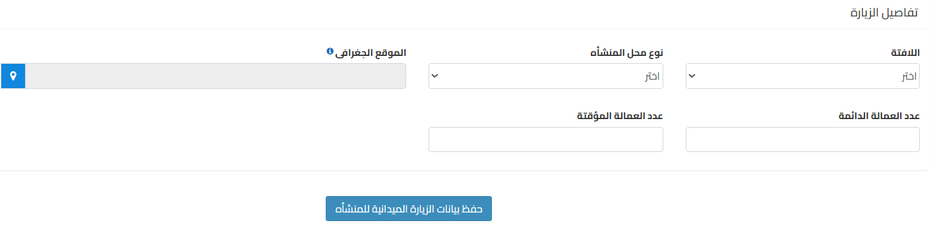
بيانات المنشأة
تفاصيل الزيارة
Flow_FieldVisits_mainController/InserUpdateFlow_FieldVisits_ORG

Slide 60
بيانات المنشأة
تفاصيل الزيارة
TDWF.Flow_FieldVisits_Organization
int FVORG_ID [ PK ]
string OrgSignID { get; set; }
StaticList In Front contains [ يوجد , لايوجد]
int WorkerCountPermanent
int WorkerCountTemporary
string Residence_Type
تمليك, ايجار جديد, ايجار قديم
string OrgRate
string GPSAddress
decimal? FVM _ID [ FK, Flow_FieldVisits_main ]

Slide 61
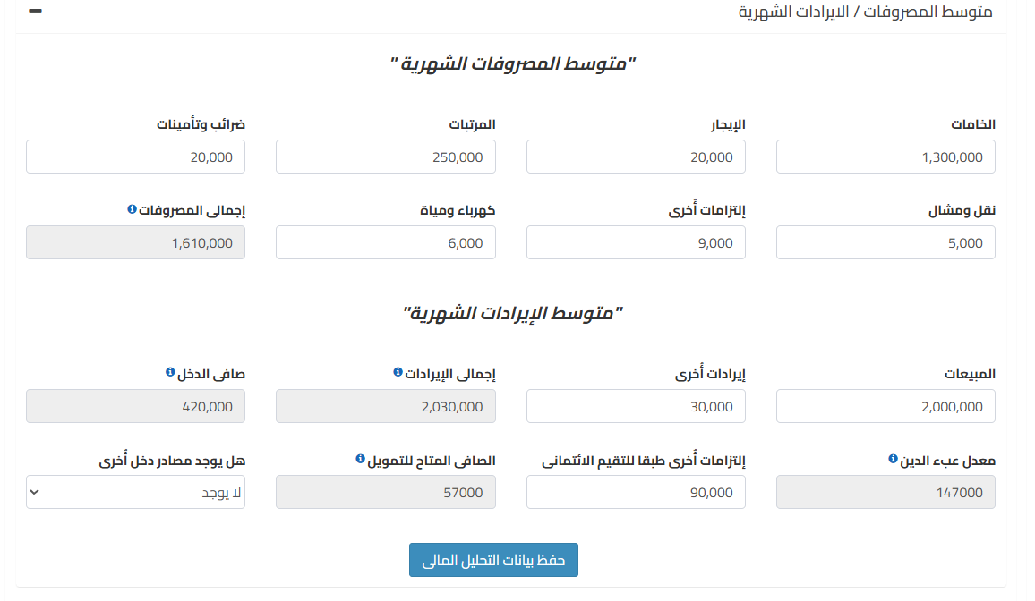
التحليل المالي
متوسط المصروفات / الايرادات الشهرية
Flow_FieldVisits_mainController/InserUpdateFlow_FieldVisits_FinancialAnalysis

Slide 62
TDWF.Flow_FieldVisits_FinancialAnalysis [التحليل المالي]
FVFA_ID: int, PK
materials: decimal // الخامات
Rent: decimal // الإيجار
Salary: decimal المرتبات
Taxs_Insurances : decimal الضرائب والتأمينات
Transport_Freight : decimal نقل ومشال
Other_Fin_obligations : decimal إلتزامات أخرى
Water_Elec : decimal: كهربا ومياه
Total_AVG_Expenses: إجمالى المصروفات لكل ما سبق
Sales: decimal المبيعات
OtherIncomes: decimal ايرادات أخرى
Total_AVG_Incomes: decimal إجمالي الايرادات
Equal : Sales + OtherIncomes
Fin_NetSalary: decimal صافي الدخل
Equal: Total_AVG_Incomes - Total_AVG_Expenses
DebtBurdenRatio: decimal معدل عبئ الدين
Equal: Fin_NetSalary * 0.35
Other_Fin_Obligations_For_Iscore: decimal
إلتزامات أٌخرى طبقا للتقيم الائتمانى
AvailableNetForLoan: decimal الصافى المتاح للتمويل
Equal: DebtBurdenRatio - Other_Fin_Obligations_For_Iscore
OtherIncomeSource: string
TotalOtherIncomeSource: decimal

Slide 63
TDWF.Flow_FieldVisits_StatisticsData
If funding is more than or equal 125K,
FVSD_ID [ PK ]
ProductName
SalesQuntity: decimal [ الكمية المباعة ]
SalesPrice: decimal
decimal PurchasePrice //سعر الشراء
decimal TotalPurchasedAmount //إجمالى قيمة الشراء = SalesQuntity * PurchasePrice
decimal TotalSaledAmount // إجمالى قيمة البيع = = SalesQuntity * SalesPrice
decimal OrgNet //الصافى = TotalSaledAmount - TotalPurchasedAmount
decimal ProfitMargin //هامش الربح = OrgNet / TotalSaledAmount
decimal SalesCostRatio // نسبة تكلفة المبيعات = 1 - ProfitMargin
decimal? FVM_ID // FK_Of_FlowField_VisitsMain_TBL

Slide 64
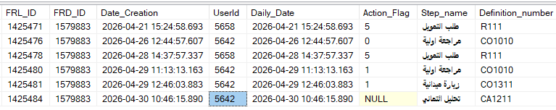
After CO Accept the request
Flow_Request
Approved_amount: from NULL to 80000
Approv_value: from NULL to 86000
Total amount: from NULL to 116640.00
NO_Months: from NULL to 15
Primium_value: from NULL to 7776.00
Flow_Request_Deportation
Code_action: 3 -- from flow_action, type code is 1
Name_step_from: زيارة ميدانية
Name_step_to: تحليل ائتماني
UserId_TO: CO
Status_two: CA1211
TDWF.Flow_Requests_Log
Last record
Action_Flag from NULL to 1 [قبول ]
New Record
UserId: CO
Action_Flag: NULL
Step_name: CA1211 // تحليل ائتماني

Slide 65
End Field visit: زيارة ميدانية, CO1311, CO

Slide 66
Start Credit Analysis, CA1211, [ تحليل ائتماني ]

Slide 67
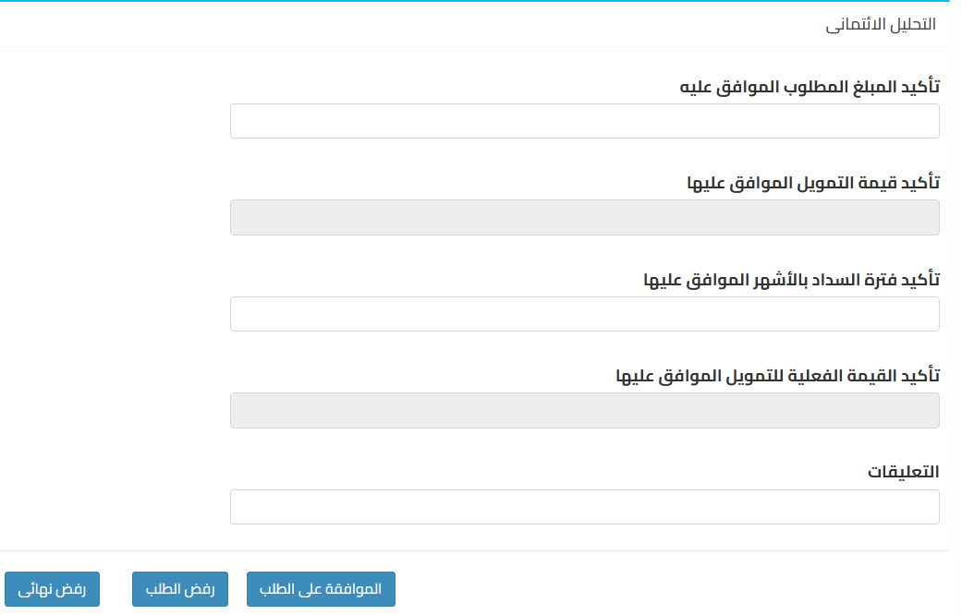

Slide 68
TDWF.Flow_Credit_Analysis
FCA_ID: [PK]

Slide 69
End Credit Analysis, CA1211, [ تحليل ائتماني ]

Slide 70
Start Uploading Documents: تحميل المستندات, BM, DU77

Slide 71
After حفظ المستندات
Flow_Funding_requestController/UploadBranchManagerDocs
TWF.TWF_Download

Slide 72
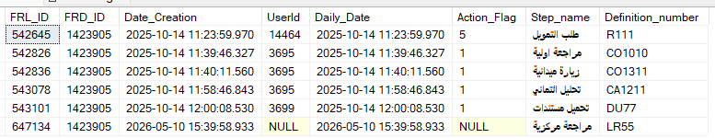
After BM Accept the request
Flow_Request_Deportation
Code_action: 5 -- from flow_action, type code is 1
Name_step_from: تحميل مستندات
Name_step_to: مراجعة مركزية
UserId_TO: NULL
Status_two: LR55
TDWF.Flow_Requests_Log
Last record
Action_Flag from NULL to 1 [قبول ]
New Record
UserId: NULL
Action_Flag: 1
Step_name: LR55 // مراجعة مركزية

Slide 73
End Uploading Documents: تحميل المستندات, BM, DU77

Slide 74
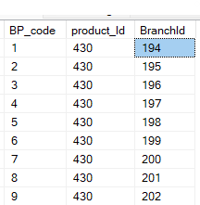
TWF. Flow_branch_product
BP_code: PK, identity
BranchId: FK from Branch
product_Id: FK from Flow_Products

Slide 75
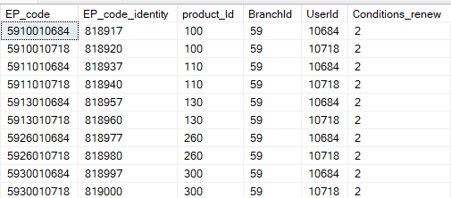
TWF.Flow_Emp_Product
EP_code_identity: int, identity
EP_code: [ PK ]
product_Id, FK
BranchId: int, FK
UserId: int, FK
Conditions_renew
1
2

Slide 76

TWF.Flow_Contact_Us
Id_contact [PK]

Slide 77
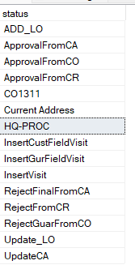
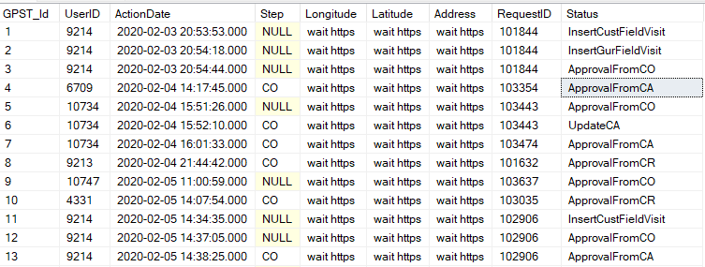
Trans.Trans_GPS_Tracking
int GPST_Id [PK]
int UserID
DateTime ActionDate
string? Step
CO
LO
CO_Organization
string Latitude
string Longitude
string Address
decimal RequestID
string Status

Slide 78
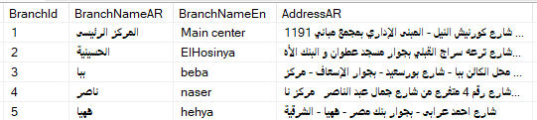
Lookup.Branch
int BranchId [PK]
BranchNameAR
BranchNameEn
AddressAR
AddressEn
ExterNum
PhoneNum
RegionId [FK]
OriginalRegionId [FK]
GovId [FK]
Code_district [FK]
Code_Section [FK]
FBT_ID [FK] (flow branch type)
IP
Branch_code
Latitude
Longitude

Slide 79
TWF.Flow_GeneralSettings
GeneralSettings_Id : PK
FinanceAmount_Approximation: decimal , تقريب قيمة التمويل وليكن لاقرب الف بعد ادخال المبلغ المطلوب فشاشات ادخال طلب وزيارة وتحليل
AllowInsertFund: int , عند إدخال طلب تمويل
AllowInsertFund == 1 // allow insert fund
AllowInsertFund ==0 // not allow insert fund
Approximation: decimal,
AllowActionOnProduct: bool
to allow add and edit on product table

Slide 80
TWF.Flow_Status_Funding_Request
int SFR_code
int UserId
int product_Id
string Status
DateTime Creation_date

Slide 81
TWF.Flow_Funding_request 1
decimal Request_id
int BranchId [FK] // the branch that funding request had done from it
ComId [FK] // is always 1 because we have only tamweely
product_Id [FK] [نوع التمويل]
bool Request_status (IsNew) [1 new , 0 renew ]
decimal Customer_ID [FK] [رقم العميل]
decimal? Enterprise_ID [FK] [المنشأة]
decimal Required_amount // المبلغ الذي طلبه العميل

Slide 82
TWF.Flow_Funding_request [cont. 2]
decimal Financing_amount //
FinanceAmountBeforeApproximations= Math.floor((Financing_amount*(1+this.ProductLayer.Ramping_Ratio/100))+this.ProductLayer.Ramping_Amount)
Financing_amount = Math.ceil(FinanceAmountBeforeApproximations/this.FinanceAmount_Approximation)*this.FinanceAmount_Approximation;
FinanceAmount_Approximation // coming from general setting
int Actual_financing // المبلغ الذي سوف يقوم العميل بتقسيطه
int Repayment period // عدد الاقساط
purpose_Id [FK] // الهدف من التمويل
1 : تمويل رأس مال عامل
2: تمويل أدوات إنتاج
3: تمويل إحلال وتجديد
int status_code [FK] // [from Flow_status]
0 : الطلب عند مسؤول التمويل
50: اغلاق التمويل
DateTime Creation_Data

Slide 83
TWF.Flow_Funding_request [cont. 3]
String Account_Code : يتم الاضافه وقت صرف التمويل
It is added upon Disbursement
, رقم حساب الدفعات المقدمة الخاصة بالعميل وده اللى من خلاله العميل بيدفع المصاريف الادارية او الدفعة الاولى او التأمين او العمولة
int DEBTNO // العميل الواحد قد يكون لديه اكثر من قرض فى نفس الوقت فهذا التسلسل الذي يفرق بين القرض الاول والثانى
عدد القروض بالنسبه للعميل هذا لان العميل ممكن يأخذ اكثر من قرض ففي كل مره يأخذ فيها العميل قرض يتم مضاعفة الرقم الموجود في هذا الحقل بمعنى أوضح العميل اخذ اول قرض من الشركة يوضع في هذا الحقل رقم 1 واذا قام بسداد القرض واخذ قرض اخر يتم وضع في هذا الحقل 2 وهكذه
int Layer_code : شريحة القرض
obtained through a inquiry within the table Flow_Products.
decimal? DEBT_VALUE
It is added upon Disbursement
its value = أصل مبلغ القرض الذي وافق عليه البنك + المصاريف الإدارية التي تضاف على القرض
قيمة متناقصة مع السداد ويتم الانقاص من هذا المبلغ مع سداد كل قسط للعميل
decimal? PRIMIUM_VALUE : مبلغ القسط
It is added upon Disbursement
ويكون المصدر من مرحلة الزيارة الميدانية ويكون من خلال حقل قيمة القسط الموجود على شاشة الزيارة الميدانية

Slide 84
TWF.Flow_Funding_request [cont. 3]
FRC_Id: its table is Flow_repayment_cycle
F_PRIMIUM_DATE : تاريخ اول قسط
Addded upon disbursement
ويتم تحديد تاريخ اول قسط من خلال معرفة نوع المنتج ودورية السداد المرتبطه به ولو هو شهر مثلا نقوم بإضافة التاريخ شهر زيادة من تاريخ الصرف وهكذه في لو أسبوع او نصف شهر وهكذه
L_PRIMIUM_DATE
Addded upon disbursement
ويتم تحديد تاريخ اخر قسط من خلال عدد الأشهر المحدد من قبل الزيارة الميدنية
DateTime BUSDATE : تاريخ الصرف
EXPDATE : تاريخ انتهاء القرض
Addded upon disbursement
ويتم تحديد تاريخ انتهاء القرض من خلال عدد الأشهر المحدد من قبل الزيارة الميدنية
ويتم التحديث على هذا التاريخ اذا تم السداد قبل انتهار التمويل مثلا اذا سدد سداد معجل

Slide 85
TWF.Flow_Funding_request [cont.]
Curr_code: [FK] العملة
decimal? Rate: سعر الفائدة الذي سيتم تطبيقه على مبلغ التمويل
decimal? COM_RAT : هي مبلغ مقطوع للمصاريف الادارية يتم استقطاعها مرة واحدة فقط عند بداية منح القرض أو التعلية
APP_FEE: عمولة الطلب وهى رسوم غير مستردة لانها تغطى تكلفة مراجعة الاوراق والاستعلام الائتماني ايز كور
int? bank_code: [FK]: المعرّف الفريد للبنك

Slide 86
TWF.Flow_Funding_request [cont.]
UserId: FK , كود الموظف الذى انشأ القرض
Approv_value : المبلغ الموصى به من المسئول الاول فقط بدون اى اضافات
Approved_Amount : missed at docs
TOTAL_AMOUNT : يتم إضافة هذا الحقل من مرحلة الزيارة الميدانية اجمالى المبلغ الموصى به وهو قيمة التمويل المطلوب + الفائده
NO_Months : عدد الأشهر الموصى به من مسئول التمويل
Yield_periodicity : دورية العائد من أجل برنامج الكشك
Code_ED : المُعرّف الرقمي للجهة المنفذة للصرف.
Grant : في حالة العميل لديه تمويل قائم وبياخد تمويل جديد علي منتج مختلف بقول التمويل الجديد قائم ولا لا قائم=0 وغير قائم =1
PenaltyAmount : اجمالى الغرامات
Flag_History
VisitCount

Slide 87
TWF.Flow_Funding_request [cont.]
GuarVisitCount:
بخزن فيه عدد المرات التي لم يستدل علي الضامن فيه لو الضامن لم يستدل عليه اكثر من مراتين بيترفض رفض نهلائي
BusDate: تاريخ الصرف
Open_date : date of request based on the busdate
EXPDATE : تاريخ انتهاء القرض
Loan_code : كود التمويل
int WriteOffFlag: التوريق
Securitization_Flag : اعدام
IsDisbursmented : // actually recieve money on his Hand Or not (but StatusCode is still = 9 )

Slide 88
TDWF.Flow_Request_Deportation [cont. 7]
After CO deports the request from critical analysis to Branch manager review
UserId_from= 4642 // the CO Id
UserId_to = 5640 // the BM
Name_step_from : تحليل ائتماني
Name_step_to: مراجعة مدير الفرع
Code_action (from: Flow_Actions): 11
Status_one: Approved // means the Name_step_from is approved
Status_two: CA1211

Slide 89
TDWF.Flow_Request_Deportation [cont. 8]
If BM Accepts the request from مراجعة مدير الفرع
UserId_from= 5640 // the BM Id
UserId_to = NULL
Name_step_from : مراجعة مدير الفرع
Name_step_to: لجنة مركزية
Code_action (from: Flow_Actions): 12
Status_one: Approved // means the Name_step_from is approved
Status_two: CMR

Slide 90
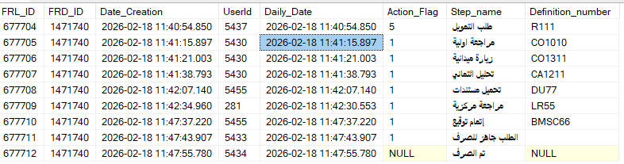

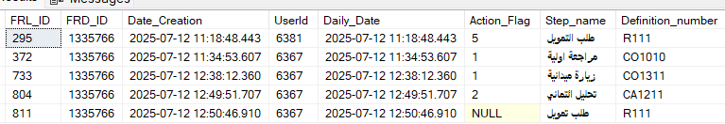
TDWF.Flow_Requests_Log
decimal FRL_ID [PK], identity
decimal FRD_ID { get; set; }
DateTime Date_Creation { get; set; }
Nullable<int> UserId { get; set; }
DateTime Daily_Date { get; set; }
Nullable<int> Action_Flag { get; set; }
0 : رفض
1 : قبول
2 : رفض نهائي
3 : رفض ضامن
4 : حفظ
5 : حفظ وإرسال
Null:
string Step_name { get; set; }
string Definition_number { get; set; } // to use it in filteration in FstReview ##
Flow_Request_Deportation Flow_Request_Deportation { get; set; }
User Users { get; set; }

Slide 91
TDWF.Flow_Requests_Log (cont.1)
After funding request is done via LO first time
Action_Flag: NULL
Step_name: طلب تمويل
Definition_number: R111
After funding request is save and send VIA LO حفظ وإرسال
After funding request is Rejected VIA CO رفض
UserId | Action_Flag | Step_name | Definition_number
1132 [ LO ] | 5 [حفظ وإرسال ] | طلب التمويل | R111
1152 [ CO ] | NULL | مراجعة اولية | CO1010
UserId | Action_Flag | Step_name | Definition_number
1132 [ LO ] | 5 [حفظ وإرسال ] | طلب التمويل | R111
1152 [ CO ] | 0 [ رفض ] | مراجعة اولية | CO1010
1132 [ LO ] | NULL | طلب التمويل | R111

Slide 92
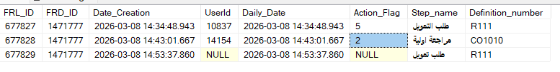
TDWF.Flow_Requests_Log (cont.2)
After the CO final reject the funding request
UserId | Action_Flag | Step_name | Definition_number
10837 [ LO ] | 5 [حفظ وإرسال ] | طلب التمويل | R111
14154 [ CO ] | 2 [ رفض نهائي ] | مراجعة اولية | CO1010
NULL | NULL | طلب التمويل | R111

Slide 93
TDWF.Flow_Requests_Log (cont.2)
After BM Deports the request from مراجعة مدير الفرع الي اللجنة المركزية
UserId | Action_Flag | Step_name | Definition_number
NULL | NULL | لجنة مركزية | CMR

Slide 94
TWF.Flow_Address_CE
Type
First: العنوان بالبطاقة
Second: العنوان الفعلي
Work: عنوان العمل
Enterprise : عنوان الشركة
CodeDistrict:أو مدينة أو مركز
CodeSection: القسم أو الحي

Slide 95
start SWF setup work flow

Slide 96

SWF.Flow_repayment_cycle [دورية السداد]
int FRC_Id [PK]
string Name_AR
string Name_EN
int Count_days: عدد الوحدات الزمنية
If Day_Month == 1 then Count_days refers to number of days
If Day_Month == 2 then Count_days refers to number of months
int Day_Month
1 refer to day
2 refers to month
int Days_in_months
ICollection<Flow_Products> Flow_Products
ICollection<Flow_Funding_request> Flow_Funding_request

Slide 97
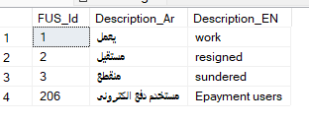
SWF.Flow_User_Status

Slide 98
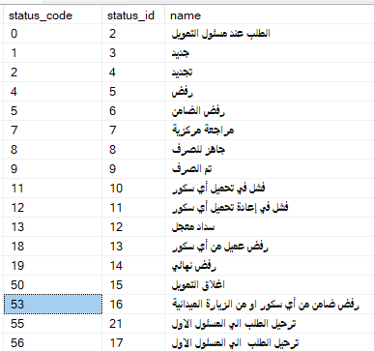
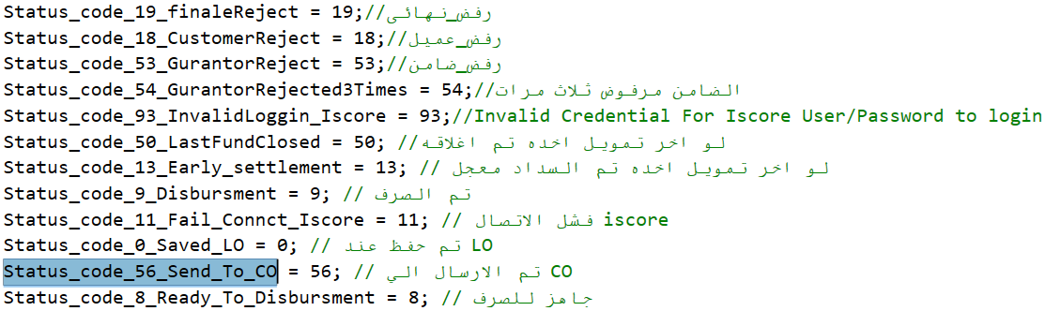
SWF.Flow_status
Tamweely.Infrastruture.Data.Project_Modules.FlowChart.SetUp , SWF schema
int status_code [PK]
int status_id [identity]
string name

Slide 99

SWF.Flow_Types
int Type_code [PK]
string description
ICollection<Flow_Actions> Flow_Actions
ICollection<Flow_Products> Flow_Products
ICollection<Flow_Request_Deportation> Flow_Request_Deportation
ICollection<Flow_Tabs_available> Flow_Tabs_available
ICollection<Flow_Action_workflow> Flow_Action_workflow

Slide 100
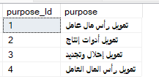
SWF.Flow_Purpose_loan
purpose_Id: int, [Key]
purpose: string

Slide 101
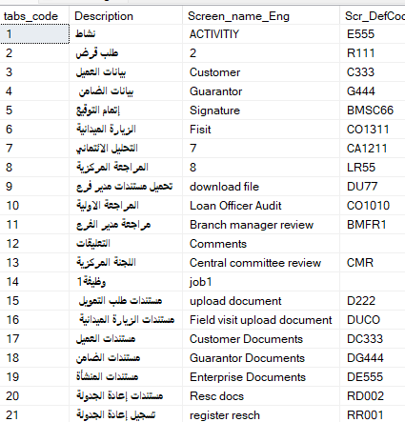
SWF.Flow_Tabs [الشاشات]
tabs_code [PK]
Description: string
Screen_name_Eng: string
Scr_DefCode: string // screen definition code

Slide 102
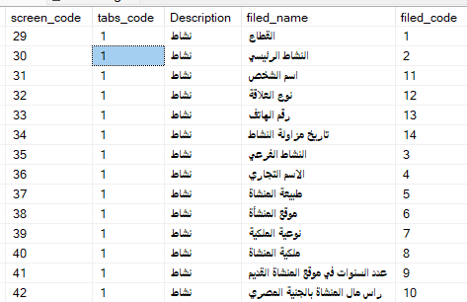
SWF.Flow_Screen_components
screen_code: int [PK], identity
tabs_code: int , [FK] from Flow_Tabs
fieldName: string
field_code: int // field number with each screen
Note: tabs_code refers to the screen
The field_code, tabs_code are together unique
Description here is from join

Slide 103
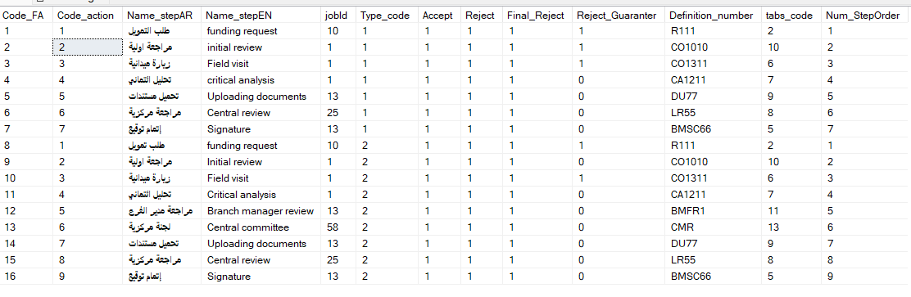
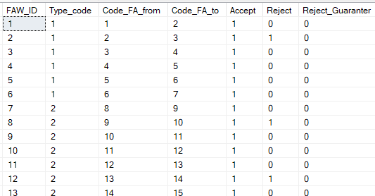
SWF.Flow_Actions , SWF.Flow_Action_workflow
Code_FA: int [PK, identity]
Flow_Actions: contains options that could be applied into each stage
Flow_Action_workflow: specify the NextStep (Code_FA_to) based on current step (Code_FA_from) and taken action [ accept / reject ]

Slide 104

SWF. Flow_Branch_Type
int FBT_ID [PK]
string Type
string TypeE
ICollection<Branch> Branches

Slide 105
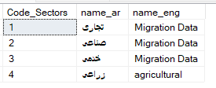
SWF.Flow_Sectors [ القطاع ]
Code_Sectors
string name_ar
string name_eng
public virtual ICollection<Flow_Enterprises> Flow_Enterprises
public virtual ICollection<Flow_Main_activity> Flow_Main_activity

Slide 106
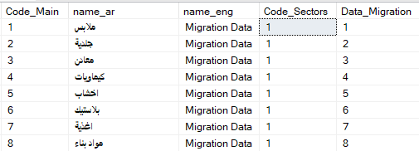
SWF.Flow_Main_activity [النشاط الرئيسي]
int Code_Main
string name_ar
string name_eng
int Code_Sectors [ FK, from Flow_Sectors ] القطاع
int? Data_Migration
virtual ICollection<Flow_Enterprises> Flow_Enterprises
Flow_Sectors Flow_Sectors
ICollection<Flow_Sub_activities> Flow_Sub_activities
ICollection<Nano_Business_Owner> Nano_Business_Owner

Slide 107

SWF.Flow_Sub_activities [النشاط الفرعي]
Code
name_ar
name_eng
Code_Main [ FK, from flow_main_activities ]
Flag_Block
Data_Migration
Flow_Main_activity Flow_Main_activity
ICollection<Flow_Enterprises> Flow_Enterprises
ICollection<Nano_Business_Owner> Nano_Business_Owner

Slide 108

SWF.Flow_Relationships
code_relation: int [PK]
name_Ar : string
name_Eng : string

Slide 109

SWF.Flow_Customers_jobs
public int Code_job
public string name_Ar
public string name_Eng
public int I_score

Slide 110

SWF.Flow_districts → [مدينة أو مركز او مركز السجل جهة الاصدار أو]
public int Code_district [FK]
public string name_ar
public string name_eng
public int GovId
public string District_DB_Code

Slide 111

SWF.Flow_Sections [الحي] [ القسم ]
Code_Section [PK]

Slide 112

SWF.Flow_Identity_Expiry
ssn_code : int
name_ar: string
name_eng: string
Expiry_date : string

Slide 113

SWF.Flow_Exchange_Destinations
This table represent جهة الصرف
Code_ED: PK

Slide 114
End SWF setup work flow

Slide 115
Start Risk

Slide 116
TWF.Flow_Risk_Branch
Risk_Branch_code: int, PK , identity
product_Id: int FK from Product
BranchId: int FK form Branch
Ratio_risk: decimal
Date_of_calculation: DateTime
Creation_date: DateTime

Slide 117
TWF.Flow_Risk_Responsible
Risk_Responsible_code: int
product_Id: int, FK from Product
UserId: int, FK from user
BranchId: int, FK form branch
Ratio_risk: decimal
Date_of_calculation: DateTime
Creation_date: DateTime

Slide 118

TWF.Flow_identi_risks_admin
R_code: int: PK
R_code_Identity: int, identity
product_Id: int, FK from Product
Number: int
AppointmentMonthsFrom: decimal
AppointmentMonthsTo: decimal
Max_loans: int

Slide 119
End Risk

Slide 120
TWT.Flow_Products
product_Id: int , PK
Loan_code: int كود التمويل
Not unique
Layer_code: int : شريحة القرض
Confirm_Score: int
name_AR: string
name_Eng: string
min_loan_amount: decimal
max_loan_amount: decimal
min_customer_age: decimal
max_customer_age: decimal
Max_Age_Guarantor
Min_Age_Guarantor
min_loan_period: decimal
max_loan_period: decimal
Ramping_Amount: int
Ramping_Ratio: decimal

Slide 121
TWT.Flow_Products [cont.]
Code_FC: FK from SWF.Flow_Finance_Category

Slide 122
TWT.Flow_Products [cont.]
int Type_code
1 : مسار عمل صغير
2 : مسار عمل كبير
Existed also at Deportation

Slide 123
TWF.Flow_Exempted_Products
Loan_Code
Product_Id [FK, Flow_Products]

Slide 124
TWF.Flow_Customers
CustomerId [PK]
creationUser [FK] from user
Identity_encoded_date: صادر بتاريخ

Slide 125
Company entity
int ComId
ComNameAR
ComNameEn

Slide 126
Acc_Chart_Account entity
namespace Tamweely.Infrastruture.Data.Project_Modules.Accounts

Slide 127
Start Security

Slide 128

Security.Sec_APIs
API_ID: PK,
ControllerName: string
ActionName: string

Slide 129

Security.Sec_Api_Pages
API_PageID: int, identity
API_ID: FK from Sec_APIs
Menu_ID: FK from SEC_Menu
ActionType: FK from SEC_Action
HasKey(t => new { t.API_ID, t.Menu_ID, t.ActionType });

Slide 130

Security.SEC_Action
Action_id: PK

Slide 131

Security.SEC_Group

Slide 132

Security.SEC_Group_Action
Id_SJA: PK, Identity
GroupId FK from SEC_Group
Action_id: FK from SEC_Action

Slide 133

Security.SEC_User_Action
Id_SUA: int, identity
UserId: int, FK from User
Action_id: int, FK from SEC_Action
HasKey(t => new { t.Id_SUA, t.UserId, t.Action_id });

Slide 134

Security.SEC_User_gruop
UserId: FK from User
Role_id: from SEC_Group //
UG_id: identity
HasKey(t => new { t.UserId, t.Role_id, t.UG_id });
Note : this table to holds the roles of the users

Slide 135

Security.SEC_Menu
Menu_id: PK, identity
M_nameAr
معاملات الفروع
صرف تمويل
M_Parent_id: int , recursive to Menu_id
Type
1: رئيسية
2: فرعية
3: صفحة
M_Status
0: غير مفعل
1: مفعل
We could say this table represent where each page in the system

Slide 136

Security.SEC_User_Role_MenuAction
URMA_id: int
Role_id: int FK from SEC_Group
Parent_Id: int FK from SEC_Menu
Child_Id: int FK from SEC_Menu
Paging_Id: int, FK from SEC_Menu
HasKey(t => new { t.URMA_id, t.Role_id, t.Parent_Id, t.Child_Id, t.Paging_Id })
Defines which role can access the menu/page for example
Pagin_Id: تعديل اسم العميل
Child_id: معاملات الفروع
Parent_id: لوحة المعلومات
Role_id: مدير النظام

Slide 137
Adding New Menu
http://localhost:2864//api/Security/MenuController/Post
Payload:
{
"Type": 3,
"M_name_AR": "نتائج الفحص الرقابي",
"M_name_Eng": "AML Results",
"M_URL": "BranchTransaction/AMLResults",
"M_Icon": "fa fa-book",
"M_Status": true,
"Project_number": 1,
"M_Parent_id": 83, // معاملات الفروع
}
Response: 3473 // the id of menu

Slide 138
End Security

Slide 139

Trans.Trans_BusDate [ تاريخ اليومية ]
Trans
Flag
0: اليومية مقفولة
1: اليومية مفتوحة

Slide 140
TWF.Flow_ISCORE

Slide 141
TWF. Flow_Risks
R_code: int , [PK]
R_code_Identity: int, [identity]
product_Id: int, [FK]
Number: int,
From_day: decimal
To_day: decimal
Name_AR: string
Name_Eng: string
Payment_way: int
Days: int
Ratio_risk: int

Slide 142

Security. SEC_Access_tokens
string Token [PK]
int UserId [FK]
Virtual User User

Slide 143

SWF.Flow_definition_expenditure
DE_code: [PK]
name_AR
name_Eng
productstatus: int
ratio: decimal
account_no [FK, Acc_Chart_Account]

Slide 144

TWF.Flow_select_definitioExp
SDE_code: int [PK]
product_Id: int [FK, Flow_Products]
DE_code: int [FK, Flow_definition_expenditure]
Confirm_Score: int
IsRejected: bool
Creation_Date: DateTime
Date_Of_Update: DateTime?

Slide 145
Start DOCS

Slide 146

SWF.Flow_Types_documents
int Document_Id, PK
string Description_Ar
string Description_Eng
int Doc_classification [FK fom Flow_Tabs]
int Doc_Size
int CodeMigrations

Slide 147

TWF.Flow_MandatoryDoc
MD_code: int , PK
MD_code_identity: int, identity
product_Id: int [FK]
Document_Id: int, [ FK , from Flow_Types_documents]
JobId: [FK, from Job]
Mandatory: bool
Loan_code: int
Flow_Types_documents Flow_Types_documents

Slide 148
TWF.TWF_Download DB table, Flow_Download class
This table represent the uploaded files for request
Id_Down: decimal, [ PK, identity ]
Screen_name: string
Doc_id: string
RequestID: string
Field_ID: int? [ NOT FK ] from SWF.Flow_Types_documents.Document_Id
Bus_Date: DateTime
Uploaded_Date: DateTime?
After حفظ مستندات via BM

Slide 149
documentsFiles
This class is filled via Documents uploading when user click on حفظ المستندات
[NotMapped]
public class documentsFiles
{
public int? Document_Id { get; set; }
public string DocId { get; set; }
public DateTime Bus_Date { get; set; }
public string Screen_name { get; set; }
public DateTime? Uploaded_Date { get; set; }
}

Slide 150
to know how to GET request docs
IQueryable<JoinMandatoryDocAndTypeDocuments> GetAllUploadedDocumentsFunding( product_Id, jobId, Request_id );
Invoked within Flow_Funding_dataService //
Funding_request.Documents = _DownloadService.GetAllDocumentsFunding(Funding_request.product_Id, Scr_DefCode, Request_id.ToString());

Slide 151
END DOCS

Slide 152
Start IScore

Slide 153

TWF.IScore_Degree
ISD: PK
From_Score
To_Score
Description

Slide 154

TWF.Flow_ISCORE
int Iscore_code [identity, PK ]
int product_Id [ PK ]
int RegionId [ FK from Region ]
int days_query_validity
int No_loans_outstanding_cust
int Days_worked_customer
int Query_result
int Loan_Code

Slide 155
TWF.Flow_ISCORE_Data
Usage: this table to store the RESULT OF INQUIRY ABOUT PERSON which fetched from XML
int Code_FID [PK]
Cust_IDNO: string // الرقم القومى الذى تم الاستعلام عنه
Inquiry_Date: DateTime // تاربخ الاستعلام
Score: int // هو رقم يعبر عن مدى التزام العميل
Open_credits [Active loans] عدد التسهيلات السارية // أي عدد القروض أو البطاقات الائتمانية التي يستخدمها العميل حالياً ولم يغلقها.
Days_Due: int أيام التأخير؛ ويقصد بها عدد الأيام التي تأخر فيها العميل عن سداد الأقساط المستحقة عليه (مؤشر خطر إذا كان الرقم كبيراً).
NO_OF_INQUIRES: عدد المرات التى تم فيها الاستعلام عن هذا الرقم
Request_id: FK
REF_NO [Ticket Number] : string , unique tracking ID assigned to a specific inquiry or request.
NotFound , int : حالة العميل
0 : يوجد للعميل هذا بيانات فى الأيزكور
1 : العميل هذا لا توجد له بيانات فى الايزكور لأنه لم يأخذ قروض من اى بنك او اى جهة من قبل
2 : يوجد مشكلة في الاتصال او اى مشكله أخرى لم تمكننى من الاستعلام عنه وبالتالي لايتم ترحيل الطلب الا اذا تم التحميل
New_ISCORE: int // all of them is 1
File_Code: string coming from uploadPdf(uploadfile)

Slide 156
TWF.Flow_Transfer_Iscore
Usage: to store the failure results of inquiry [ status of request 11, 12 ]
ISCORE_CODE: int PK, identity
IDNO: string, national Id
Request_Id: FK: decimal
FLAG_ISCORE: int -----
AMT: int , the Actual_financing field
LOAN_TYPE: int
USRNO: int
CUST_TYPE: string -- C for customer, G for guarantor
BranchId: int FK from branch
BIRTHDATE: DateTime
Gender: int
FIRST_NAME
MIDDEL_NAME
LAST_NAME
CREATION_DATE: datatime

Slide 157

TWF.Flow_log_Iscore_Test
int LIT_ID, PK
string TYPE
string IDNO
DateTime DATETIME
int STATUS
decimal Request_Id

Slide 158

TWF.Flow_Iscore_Param
ID: int, PK , identity
USRNAME
PW: string
Date_of_Password: datetime
PassExpDate: datetime
NoExpDate: int
Code_IQT: FK from Flow_IScore_Query_Type

Slide 159

SWF.Flow_IScore_Query_Type
int Code_IQT
string DescriptionAr
string DescriptionEn

Slide 160
TWF.Flow_Iscore_Param_Notifi
FIPN_Id: PK. Identity
string Email { get; set; }
DateTime Creation_Date { get; set; }
ID: FK fom Flow_Iscore_Param

Slide 161
شاشة اعادة تحميل الأي سكور
At ReloadIScoreController
ReloadIScoreAllVM GetAll()
Fetches funding requests with status 11 or 12
ReloadIScore : records with status 11
ReloadIScoreDev : records with status 12
Returns both lists inside ReloadIScoreAllVM

Slide 162
When choosing requests and reload them
ReloadIScoreController BulkReloadIScore ([FromBody] List<ReloadIScoreVM> entity)
It calls BulkReloadIScore which calls PostIScore (List<ReloadIScoreVM> entity)
For each ReloadIScoreVM item
Get all Flow_Transfer_Iscore Where(x => x.Request_Id == item.RequestId)
For each Flow_Transfer_Iscore row
Get the Request = Flow_Funding_request. FirstOrDefault(x => x.Request_id == item.RequestId);
IscoreFlag = callTransferIscore ( Flow_Transfer_Iscore row, item.Loan_Code , request.Creation_Data )
if (Request.status_code == Status_code_11_FialedIScore && (IscoreFlag == 93 || IscoreFlag == -1 || IscoreFlag == 0))
UpdateRequest(Request, Status_code_12_FailedReloadIScore);
if (IscoreFlag == 93) IscoreFlagG = 93;
Else if (Request.status_code == 0 && (IscoreFlag == 0))
UpdateRequest(Request, Status_code_0_);
else if (IscoreFlag == -2) IscoreFlagG = -2;
Return IscoreFlagG

Slide 163

String IscoreEnquery (Flow_Transfer_Iscore, Request.CreationDate)
path = ConfigurationManager.AppSettings["UploadXMLLogs"]; // D:\Master\IscoreManual\Files\IScore_Log\Json_Log\
xmlFleIscore = ConfigurationManager.AppSettings["UploadXMLFileIscore"] // D:\Master\IscoreManual\Files\IScore_Log\Xml_Log\
_log_Iscore_TestService.Add_LogIscorTest("B", Flow_Transfer_Iscore.IDNO, 0, Flow_Transfer_Iscore.Request_Id);
IscoreParam = _Iscore_Param.Queryable().FirstOrDefault(x => x.Code_IQT == 1); //
PRODUCT_ID = ConfigurationManager.AppSettings["PRODUCT_ID"]; // 140033
APPLICATION_DATE = Request.CreationDate // used in xmlMessage
xmlMessage = …… //
url = ConfigurationManager.AppSettings["IscoreURL"] // https://uat.i-score.com.eg/SbxLiveRequest/api/LiveRequest/
IscoreApiKey = ConfigurationManager.AppSettings["APIKey"] // sxpUhKRCJc6t06h0GMznol1SSfJELnjffKgFJtMy_1
HttpClient client = new HttpClient(); Client.DefaultRequestHeaders.Add("api_key", IscoreApiKey );
responseMessage = client.SendAsync(request).Result;
vResult = responseMessage.Content.ReadAsStringAsync().Result; // look at the next page to see the Iscore Result
_log_Iscore_TestService.Add_LogIscorTest("A", Flow_Transfer_Iscore.IDNO, 1, Flow_Transfer_Iscore.Request_Id);
path = path + Data.IDNO + "_JSON_" + DateTime.Parse(DateTime.Now.ToString()).ToString("dd_MM_yyyy", CultureInfo.InvariantCulture) +".text";
Path = D:\\Master\\IscoreManual\\Files\\IScore_Log\\Json_Log\\29811252100222_JSON_14_04_2026.text
File.WriteAllText(path, vResult); // save the vResult as text
Step to save the result as XML too
Return the vResult

Slide 164


IsCore Enquiry Result
This is the vResult in the IscoreEnquery
IsNoHit = true : user not found in iscore

Slide 165
What IscoreDataFound method do
Flow_ISCORE_Data IscoreDataFound(string IDNO)
Return the result of the last inquiry of the person
Where(x => x.Cust_IDNO == IDNO).OrderByDescending(x => x.Inquiry_Date).FirstOrDefault()

Slide 166


What callTransferIscore( Flow_Transfer_Iscore row, item.Loan_Code , request.Creation_Data ) method do
ISCORE_DATA =_ISCORE_DataService.IscoreDataFound(Data.IDNO) – بيرجع اخر استعلام عن العميل
Branch = _BranchService.GetCurrentBranch(Data.BranchId);
BusDate = _BusDateService.GetBusDateBrach(Branch.BranchId); // get branch bus date
IscoreParamVaid = _ISCOREService.GetIscore( loan_Code, Branch.RegionId ); // get Flow_Iscore
var IscoreParamVaid = _ISCOREService.GetIscore(loan_Code, Branch.RegionId); -- نجيب شروط الشركة
[numberOfDays] بنجيب عدد الايام من أخر استعلام
numberOfDays > NO_EXP_DATE لو حالة البيانات قديمة
bool notfound = (bool)jsonObject["IsNoHit"]; // true means not found in iscore
String IscoreJson = IscoreEnquery(Flow_Transfer_Iscore row , request.Creation_Data) : يعمل استعلام جديد
if no error occurs when consuming the isCore
string vPDFStream = (string)jsonObject["Response"]["PDFStream"]; //
uploadfile.file = vPDFStream; uploadfile.FileName = Data.IDNO + ".pdf";
uploadfile.nameProject = "Master"; uploadfile.Request_id = Data.Request_Id.ToString();
uploadfile.Request_id = Data.Request_Id.ToString();
var fileId = uploadPdf ( uploadfile ); // Mjk4MTEyNTIxMDAyMjIoN2FjMjEwYWItNWM5NS00MWQ3LTk3OWYtNDRlOTc3MjYzNjI5KS5wZGY=
InsertDocument (documentsFiles, Flow_Transfer_Iscore.RequestId )
Flow_Download row is added

Slide 167
What callTransferIscore do [cont.]
numberOfDays > NO_EXP_DATE لو حالة البيانات قديمة // complete from the previous
If (bool)jsonObject["IsNoHit"] == true // no found in iscore
_ISCORE_DataService. InsertIscoreData( Flow_Transfer_Iscore.IDNO, fileId, Flow_Transfer_Iscore.Request_Id, REF_NO, 0,0, 0)
- fileId is coming from uploadPdf method
InsertIscoreData(string IDNO, string fileId, decimal Request_id, string REF_NO, int score, int ACTIVE_LOANS, NO_OF_INQUIRIES )
UpdateFlagTo0 (Data.Request_Id); // update status code of request to 0
If founed in iscore
Get Score, NO_OF_INQUIRIES, ACTIVE_LOANS from IsCore Reslt [ vResult ]
ISCORE_DataService. InsertIscoreData( Flow_Transfer_Iscore.IDNO, fileId, Flow_Transfer_Iscore.Request_Id, REF_NO, score, ACTIVE_LOANS, NO_OF_INQUIRIES)
if ((score >= SCORE || score == 0) && (ACTIVE_LOANS <= NO_CURR_LOAN || ACTIVE_LOANS == 0))
The UpperCase SCORE is from Query Result of Flow_ISCORE
UpdateFlagTo0(Data.Request_Id);
Else :
Data.CUST_TYPE == "C“ ? UpdateFaildIscoreCustomer(Data.Request_Id): UpdateFaildIscoreGuarnter(Data.Request_Id);
_Rej_GuarService.AddRej_Guar(Data.IDNO, Data.Request_Id);

Slide 168



Slide 169
Host
To test IScore
C:\Windows\System32\drivers\etc
At this to you hosts file
10.1.2.10 uat.i-score.com.eg // by Mustafa zidan

Slide 170
END IScore

Slide 171
Start Forget Password

Slide 172

Lookup.ForgetPasswordOTP
OTP_ID: int , key
string UserCode
string UserEmail carries email [ local or eg or mobile ]
string ActiveCode
DateTime ExpireDate
Notes
User has only 3 times Generate password OTP per day and determined based on General_setting.Exchange_Code
If Exchange_Code = 1 then no.of passwordOTP per day is 3 else no.of passwordOTP per day is 5

Slide 173

Forget password
api/Security/LoginController/ForgetPassword
String LoginService.ForgetPassword([FromBody] ForgetPasswordVM )

Slide 174
steps
GET user by UserCode (include MobileNumbers)
IF user is in MAIN branch (BranchId == 1) AND Email is empty
RETURN "selectYourRightBranch" // main branch requires email
ELSE IF user is NOT in main branch (BranchId != 1) AND MobilePhone is empty
return "selectYourRightBranch";
GET system setting Exchange_Code and assign it to (codeUnified)
GET userMobile matching input.MobilePhone
IF user exists , note if not exit RETURN "2“
if (!user.BlockFlag || user.FUS_Id != 1) return "9"
IF Email provided AND does NOT match user's email RETURN "1“
IF Mobile provided
IF no matching mobile found RETURN "22“
IF mobile does NOT match RETURN "11“
GET count of OTP sent today
SET maxPerDay = (codeUnified == 1 ? 5 : 3)
IF count < maxPerDay
------------- >>>>>

Slide 175
Steps [ cont .]
IF count < maxPerDay
GENERATE OTP code
CREATE new OTP entity
UserCode - ActiveCode - CreationDate = now - ExpireDate = now + 5 minutes - Contact = (Email OR Mobile)
MAIN branch → Email flow
IF Email provided
IF email domain is "tamweely.local“
SEND local email IF success ==“0” → save OTP RETURN result
ELSE IF email domain is "tamweely.com.eg“
SEND normal email IF success==“0” → save OTP RETURN result
Else
RETURN "11"
ELSE IF Mobile provided
IF codeUnified == 1
SET expire = 30 minutes
SET OTP = first 6 digits of national ID
SAVE OTP
RETURN "01"
SEND SMS
IF success → save OTP
RETURN result
Else of count < maxPerDay
RETURN "3" // exceeded daily limit

Slide 176
End Forget Password

Slide 177
MenuRoleForLoginVM
Menu_id
M_nameParent_AR
M_nameParent_Eng // Main menu name
M_nameChild_AR
M_nameChild_Eng // Submenu name
M_namePage_AR
M_namePage_Eng // Page name
M_Parent_id
M_URL
M_URLParent
M_URLChild
M_URLPage
M_Icon
Role_id
Parent_Id
Child_Id
Paging_Id
M_Status
Type
TypeName
MenuItem
URMA_id
Role_id
Parent_Id
Child_Id
Paging_Id

Slide 178
Get User group

Slide 179
Start login

Slide 180
End login

Slide 181
Start Users page مستخدمي النظام

Slide 183
End Users page مستخدمي النظام

Slide 184

Lookup. Mobile_Numbers
MN_ID: int , PK
Mobile: string
UserID: int , FK from User

Slide 185
BranchGovernRegion VM
BranchId // From Table branch
Branch_code // From Table branch
ExterNum // From Table branch

Slide 186
Amounts of Funding request
Required_amount : المبلغ الذي كتبه العميل في "نموذج الطلب" بناءً على احتياجه الشخصي.
Financing_amount : قيمة التمويل بعد التعلية
Actual_financing : المبلغ الصافى الذى خرج من الخزينة وذهب للعميل
COM_RAT : عمولة المنح وهي مبلغ مقطوع للمصاريف الادارية
DEBT_VALUE : قيمة المديونية (أصل القرض + الفوائد + عمولة المنح). وهي قيمة متناقصة تقل مع كل عملية سداد يقوم بها العميل.
APP_FEE : رسوم إدارية ثابتة تُدفع نقداً عند تقديم الورق، وغالباً لا تُسترد حتى لو رُفض الطلب
PRIMIUM_VALUE : مبلغ القسط
Rate : سعر الفائدة الذي سيتم تطبيقه على مبلغ التمويل
Approve_Value :
Approved_Amount:
Total_Amount :
PenaltyAmount : إجمالى الغرامات

Slide 187
Jobs
Loan officer login: 10100 , P@ssw0rd
JobName | Job Id | Job Code
Loan officer (LO) مسؤول تمويل | 10 | 0
Branch Manager مدير فرع | 13 | 3
Teller (money man) صراف | 12 | 2
CO | 1 | 1
District Manager | 24 | 15
Software developer [مطور برمجيات] | 1288 | 1288

Slide 188
Calculations

Slide 189
Financing_Amount, Approv_value
FinanceAmount_Approximation // From General Settting
Financing_amount = Required_Amount
The Calc:
Let FinanceAmountBeforeApproximations= Math.floor((Financing_amount*(1+this.ProductLayer.Ramping_Ratio/100))+this.ProductLayer.Ramping_Amount)
Financing_amount = Math.ceil(FinanceAmountBeforeApproximations/this.FinanceAmount_Approximation)*this.FinanceAmount_Approximation;

Slide 190
Actual Financing == Total_Amount
repaymenyCycle = Days_in_months * Repayment_period
If Product.Pricing_responsible == 0
FirstResult = Financing_amount / (1 - (this.Commission / 100 ) ); // اصل المبلغ مع عمولة المنح
SecondResult = ( ( FirstResult * ( this.LoanInterest / 100) ) * repayment_cycle / 360); // حساب الفايدة
Total = FirstResult + SecondResult; // إجمالي المبلغ قبل التقريب
Result = Total / Repayment_period;
Prim_value = Math.ceil( Result / this.Approximation ) // Approximation from General Setting
Final_Prim = parseInt(Prim_value) * this.Approximation; //
If Product.Pricing_responsible != 0
SecondResult = ((Financing_amount * (this.LoanInterest / 100)) * repayment_cycle / 360);
Total = parseInt(Financing_amount) + SecondResult; // المبلغ قبل التقريب
Result = Total / Repayment_period;
Prim_value = Math.ceil(Result / this.Approximation) //
Final_Prim = parseInt(Prim_value) * this.Approximation; //

Slide 191

Commision [ عمولة المنح الخاصة باالمنتج ]
At: Flow_FieldVisits_mainService GetPercentageBonusCommission(ProductId, RequestStatus)

Slide 192
Loan Interest[ فايدة التمويل ]
It depends on
Flow_Product.Fixed_return_new
Flow_Product.Fixed_return_renew
Funding_request.Request_status

Slide 193
Funding_request.APP_FEE & Funding_request.Rate
Funding_request.APP_FEE = IsNew==true ? Product.Com_submit_new_app : Product.Com_submit_renew_app;
Funding_request.RATE = IsNew == true ? Product.Fixed_return_new : Product.Fixed_return_renew;
Note that Rate is like loan interest at previous page

Slide 194

Male & Female from QID
code

Slide 195
Start Flags

Slide 196
SWF. Flow_status: [ Table ]
FK : in Flow_Funding_request as status_code
11 : FixedStatus.Status_code_11_Fail_Connct_Iscore فشل في تحميل أي سكور
12: فشل فى إعادة تحميل الأي سكور
0 : FixedStatus.Status_code_0_Saved_LO الطلب تم حفظه عند مسئول التمويل
56 : FixedStatus.Status_code_56_Send_To_CO الطلب تم ترحيله إلى المسؤول الأول
19 : FixedStatus.Status_code_19_finaleReject الطلب تم رفضه نهائي من قبل المسئول الاول
18 : FixedStatus.Status_code_18_CustomerReject رفض_عميل من الأى سكور
19 : FixedStatus.Status_code_19_finaleReject رفض نهائي
8 : FixedStatus.Status_code_8_Ready_To_Disbursment جاهز للصرف
9 : FixedStatus.Status_code_9_Disbursment تم الصرف
53 : FixedStatus.Status_code_53_GurantorReject رفض ضامن من الأي سكور أو من الزيارة الميدانية
50: إغلاق تمويل
13: سداد معجل

Slide 197
Request_status
Column at Flow_Funding_Request
bool Request_status (IsNew) [1 new , 0 renew ]

Slide 198
Action_Flag
Column in Flow_Requests_Log not FK
Nullable<int> Action_Flag { get; set; }
0 : رفض
1 : قبول
2 : رفض نهائي
3 : رفض ضامن
4 : حفظ
5 : حفظ وإرسال

Slide 199
SWF.Flow_User_Status
FUS_Id: 1: يعمل
FUS_Id: 2: مستقيل
FUS_Id: 3 منقطع
FUS_Id: 206 مستخدم دفع الكترونى

Slide 200
END Flags

Slide 201
Start Business

Slide 202
نتحدث الأن عن الطلب:
الطلب يرفض نهائي اذا الضامن الأول تم رفضه وقام العميل بجلب ضامن ثاني وتم رفضه أيضا وقام العميل بجلب ضامن ثالث وتم رفضه أيضا
عدد الضامنين الذي تم رفضهم هم 3 وهذا يتسبب برفض نهائي للطلب
من أين قمنا بتحديد ان عدد الضامنين الذي يجب رفضهم حتى يؤدي الى الرفض النهائي للطلب [ GeneralSetting. MaxGuarantorsPerRequest ]

Slide 203
كود الصرف
هناك حد أقصى من المرات لارسال كود الصرف, يتم تحديده داخل جدول الاعدادات العامة , GeneralSetting.MaxDisbursementCode

Slide 204
End Business

Slide 206
Start Rescheduling

Slide 207

RSC.ReschedulingStatus

Slide 208

RSC.RscCalculation
RC_ID: int, PK
Calculation_Way: string

Slide 209
RSC.RscSetup
RS_ID: PK
Type: string
Max_Resc_Months: int, الحد الأقصى لمدة الجدولة
Grace_Period: int, فترة السماح
Resc_Commission: int, عمولة إعادة الجدولة
Resc_expenses: decimal, مصروفات إعادة الجدولة
Resc_Return_Ratio: decimal, نسبة عائد إعاد ة الجدولة
Min_Premium_Num: int, الحد الأدني لعددالأقساط المتبقية
Max_Premium_Num: int, الحد الأقصى لعدد الأقساط المتبقية
Cust_Guar: int
RscCalculations: FK from RscCalculation
FRC_Id: FK from Flow_Repayment_Cycles

Slide 210

RSC.ReschedulingCustomers
RC_ID: PK
CustomerId: FK from customer
RequestId: FK from Request
Status: FK from ReschedulingStatus
RS_ID: FK from RscSetup
BranchId: FK from BranchId
UserID: FK from User
creationDate: DateTime
ReschedulingCustomers

Slide 211
We have customer and guarantor rescheduling

Slide 212
RSC.ReschedulingCustomers
cust_guar:
1 [ عميل ]
2 [ ضامن ]

Slide 213
To calc إجمالي المديونية المستحقة
From Trans.Trans_Premiums get Sum (Primium_Value - Settlement_Value) where requestId = requestId + Req.PenaltyAmount

Slide 214
End Rescheduling

Slide 216
START TABLE

Slide 217
TWF.Flow_Enterprises
Enterprise_ID [PK], [identity]
Brand_name: اسم الشركة
Code_Sector: تجاري → نوع النشاط
Nature_enterprise: النشاط التجاري
Code_main: النشاط الرئيسي
Code: النشاط الفرعى
Type_enterprise: طبيعة المنشأة
Org_Id
Commercial_Reg_num: رقم السجل التجاري
TaxFile: رقم البطاقة الضريبية
Code_district: الجهة الصادرة للاسم التجاري
ICollection<Flow_Funding_request> Flow_Funding_request

Slide 218
Enterprise → TWF.Flow_Enterprises

Slide 219
End TABLE

Slide 220
START AML

Slide 221
When It used
In Micro it is executed after the iscore

Slide 222
TWF.Flow_Sanctionscanner_ByID
This table represents the result of AML

Slide 223
End AML

Slide 224
View Models

Slide 225
FlowActionsNameStepFromTo
Code_FA_from: int
Name_stepARFrom: string
Name_stepENFrom: string
Definition_numberFrom: string
Code_FA_to: int
Name_stepARTo: string
Name_stepENTo: string
Definition_numberTo: string
Type_code: int
JobCode_FA_From: int
JobCode_FA_to: int
Accept: bool
Reject: bool
Final_Reject: bool
Reject_Guaranter: bool
Num_StepOrder: int

Slide 226
FundingData
decimal Request_id
DateTime Date_creation_request
string Name_step_to
string Status_two
int product_Id
string product_name_AR
string product_name_Eng
decimal Customer_ID_C
string CustomerFullName
decimal CustomerQID
string Enterprise_ID
string Brand_name
int? UserId_from
UserfromNameAR
UserfromNameEng
List<GuarVM> Guaranters
decimal Guaranter_ID
string GuaranterQID
string GuaranterName
int Serial
int code_relation
BranchId
DateTime? Date_Assigned

Slide 227

FundingDataVM

Slide 228
ProdVM
public class ProdVM {
public IQueryable<Flow_branch_product> BranchProduct { get; set; }
public IQueryable<Flow_Products> Products { get; set; }
public IQueryable<Flow_Emp_Product> EmpProduct { get; set; }
}

Slide 229
public class FundindPageLoadVM {
public IQueryable<Flow_Purpose_loan> Purpose_loan { get; set; }
public IQueryable<Flow_Relationships> Relationships { get; set; }
public IQueryable<Flow_Exempted_Products> flow_exempted_products { get; set; }
public decimal Approximation { get; set; }
public decimal FinanceAmount_Approximation { get; set; }
public ProdVM ProdVM { get; set; }
}

Slide 230
public class FundingVM
{
public Flow_Funding_request Funding_request { get; set; }
public IQueryable<JoinMandatoryDocAndTypeDocuments> Documents { get; set; }
public IQueryable<Flow_Rejections_mainVM> Comments { get; set; }
public IQueryable<Flow_Rejections_mainFieldVM> RejectedFields { get; set; }
public IQueryable<GuarVM> Guaranters { get; set; }
//public Flow_Enterprises Flow_Enterprise { get; set; }
public IEnumerable<Product_destinationVM> Flow_Product_destinations { get; set; }
public IQueryable<Cheque_InformationDTO> cheque_Information { get; set; }
public int Flag { get; set; }
}

Slide 231


TransactionVM

Slide 232
sd

Slide 233

To make migration
At Tamweely.Infrastructure.Data / migrations / at Configuration class / constructor
AutomaticMigrationsEnabled = true;
AutomaticMigrationDataLossAllowed = true;
At Tamweely.Service.WebAPI / Global.asax.cs
Uncomment this code

Slide 234



Slide 235



Slide 236

COفي المراجعة الأولية عند ال
The Tab of funding data will be blocked

Slide 237


Slide 238


Slide 239



Slide 240
VendorRequest
User_
Vendor_Deportation
From: تسجيل المورد
To: تحميل مستندات المورد
StatusOne: inProcess
StatusTwo:
Vendor_Log

Slide 241
Status Code of vendor
After Save at Vendor Registeration the status code will be 1
After حفظ وإرسال at Vendor Registeration the status code will be 2
After reject at phase [المراجعة الائتمانية] the status code will be 6
After Accept at phase [المراجعة الائتمانية] the status code will be 3 [دراسة مكافحة غسل األموال]
After reject At AML Phase the status code will be 2 [مراجعة متابعة الائتمان]
After Accept at AML Phase the status code will be 4 [vendor account creation – حساب إنشاء للمورد
After final reject at AML Phase the status code will be 7
After فتح حساب للمورد the status code will be 5 [approved]

Slide 242
After Save ate vendor registration
Flow_Vendor_Request
StatusCode: 1
Deportation
UserId_from: the Id Of BM Who made the vendor reqquest
UserId_TO : the Id Of BM Who made the vendor request
UserId_BM: _LoToCo.Queryable().FirstOrDefault(x => x.BranchId == addVendorDTO.BranchId).Manager_User
Name_step_from: تسجيل بيانات مورد
Name_step_to: تحميل مستندات مورد
Status_one: Inprocess
Status_two: BM1010
Creation_Date: DateTime.Now
DateAssigned: the date when it is assigned to UserIdTo
Log
UserId: UserIdTo
Daily_Date: datetime.now
Action_Flag: 4;
Step_name: تسجيل مورد
Definition_number: BM1010

Slide 243
After Reject Vendor AML Step
VendorRequest
StatusCode: 2
Deportation
Name_step_from: مراجعة AML
Name_step_to: مراجعة الائتمان
Status_one: “Reject”
Status_two: CD1020 [كود مرحلة مراجعة الإتمان]
UserId_from : Id of current مشرف مخاطر الإتمان
UserId_to: the prev user who deport the request [بتاع مراجعة الإتمان]
Log
Last Log:
Action_Flag: 0 رفض
New log
UserId: UserId_to // this always like UserId_to
Step_name: مراجعة الائتمان
Definition_number: CD1020 [ stepCode of مراجعة الائتمان]
Vendors_Rejections_main
Rejection_flag: 2 [note: 1 final reject]
Remarks: mandatory
UserId: like UserIdFrom [the one who reject]
Reject_by_phase: AML1030
InsertDate: DateTime.Now

Slide 244
After Final Reject Vendor AML Step
VendorRequest
StatusCode: 7
Deportation
Name_step_from: مراجعة AML
Name_step_to: NULL
Status_one: “Final Reject”
Status_two: NULL
UserId_from : Id of current مشرف مخاطر الإتمان
UserId_to: BM_ID
Log
Last Log:
Action_Flag: 2 رفض نهائي
New log
UserId: BM_ID // this always like UserId_to
Step_name: تسجيل مورد
Definition_number: BM1010
Vendors_Rejections_main
Rejection_flag: 1 [note: 2 reject]
Remarks: optional
UserId: like UserIdFrom [the one who reject]
Reject_by_phase: AML1030
InsertDate: DateTime.Now

Slide 245
After Accept Vendor at AML Step
VendorRequest
StatusCode: 4
Deportation
Name_step_from: مراجعة AML
Name_step_to: حسابات
Status_one: “Approved”
Status_two: ACC1040
UserId_from : Id of current مشرف مخاطر الإتمان
UserId_to: NULL
Log
Last Log:
Action_Flag: 5 موافقة
New log
UserId: NULL // this always like UserId_to
Step_name: حسابات
Definition_number: ACC1040

Slide 246
End Vendor

Slide 247
SWF.BankingActivityCode [SMEs]
ID: PK, int
Name: string
CenteralCode: string
at Enterprise there are BAC, BAC2
BAC: FK from BankingActivityCode
BAC2: FK from BankingActivityCode

